Slide 1
Submodularity and its application in Social Network Analysis
Attila Kiss
Department of Information Systems
Eötvös Loránd University, Budapest, Hungary
This work was partially supported by the European Union and the
European Social Fund through project FuturICT.hu (grant no.:
TAMOP-4.2.2.C-11/1/KONV-2012-0013) and with the support of the Hungarian and
Vietnamese TET (grant agreement no. TET 10-1-2011-0645).
Vietnam, 2014

Slide 2
Outline
Social networks
Information diffusion and social effect maximization
Submodular functions and their applications

Slide 3
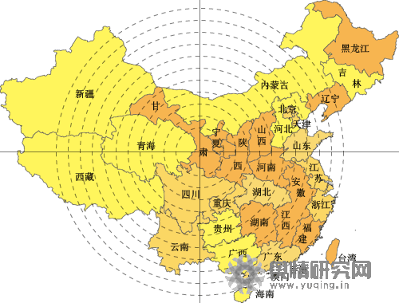
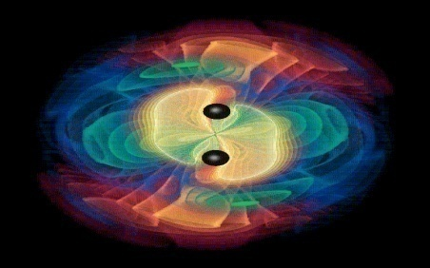
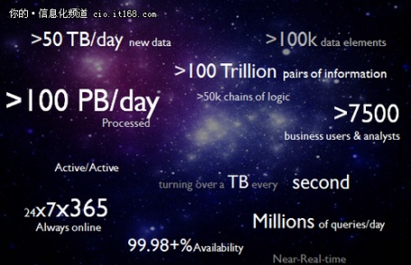



Social Networks
SN bridges our daily life and the virtual web space!
Opinion Mining
Innovation diffusion
Business Intelligence
Infor-mation Space
Information→ user
Interaction mechanism
Interaction
Social Space

Slide 4
Overview of Core Research in Social Networks

Slide 5
Core Research in Social Network
Application
Prediction
Search
Information Diffusion
Advertise
Macro
Meso
Micro
Social Network Analysis
BA model
ER model
Community
Group behavior
Dunbar
Social tie
Action
Social influence
Theory
Social Theories
Algorithmic Foundations
BIG Social Data

Slide 6
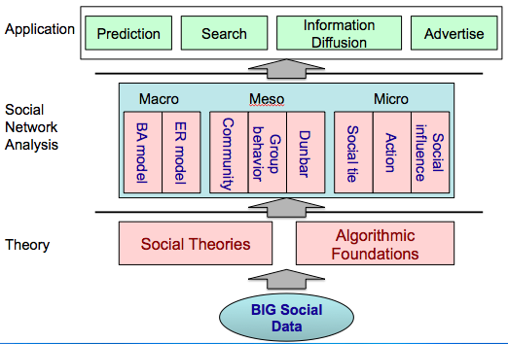
Computational Foundations for Social Networks

Slide 7
Computational Foundations
Social Theories
  Social balance
  Social status
  Structural holes
  Two-step flow
Algorithmic Foundations
  Network flow
  K-densest subgraph
  Set cover

Slide 8
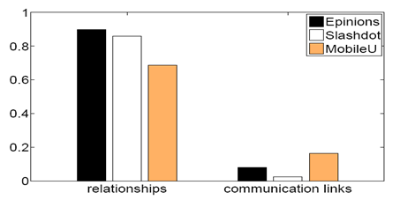
Social Theories—Social Balance
Your friend’s friend is your friend, and your enemy’s enemy is also your friend.
Examples on Epinions, Slashdot, and MobileU
(1) The underlying networks are unbalanced;
(2) While the friendship networks are balanced.
Jie Tang, Tiancheng Lou, and Jon Kleinberg. Inferring Social Ties across Heterogeneous Networks. In WSDM'2012. pp. 743-752.

Slide 9
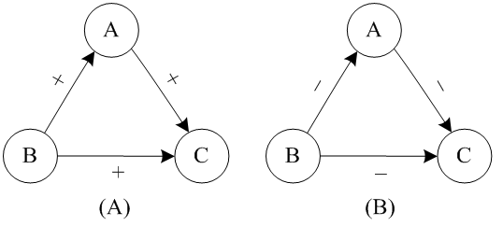
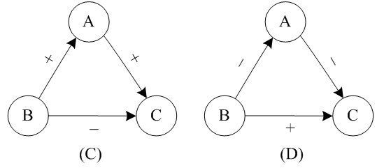
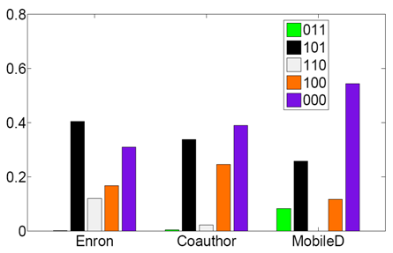
Social Theories—Social status
Your boss’s boss is also your boss…
Observations: 99% of triads in the networks satisfy the social status theory
Examples: Enron, Coauthor, MobileD
Note: Given a triad (A,B,C), let us use 1 to denote the advisor-advisee relationship and 0 colleague relationship. Thus the number 011 to denote A and B are colleagues, B is C’s advisor and A is C’s advisor.
Jie Tang, Tiancheng Lou, and Jon Kleinberg. Inferring Social Ties across Heterogeneous Networks. In WSDM'2012. pp. 743-752.
Notes:
early 99% of Triads in The three networks satisfy the social status theory, and they share a similar distribution on the five frequent forms of triads.

Slide 10
Triadic Closure
R. Milo, S. Shen-Orr, S. Itzkovitz, N. Kashtan, D. Chklovskii, U. Alon. Network Motifs: Simple Building Blocks of Complex Networks. Science, 2004
Notes:
相同系统之间的模体显著性 指标具有 很高的相似度，而且可能有不同的学科之间会存在很高的相关性

Slide 11

Social Theories—Structural holes
Community 2
Community 1
1% twitter users control 25% retweeting behaviors between communities.
Information diffusion across communities
Structural hole spanners
Community 3
Structural hole users control the information flow between different communities (Burt, 92; Podolny, 97; Ahuja, 00; Kleinberg, 08; Lou & Tang, 13)
T. Lou and J. Tang. Mining Structural Hole Spanners Through Information Diffusion in Social Networks. In WWW'13. pp. 837-848.

Slide 12
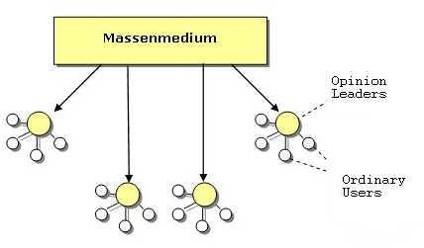
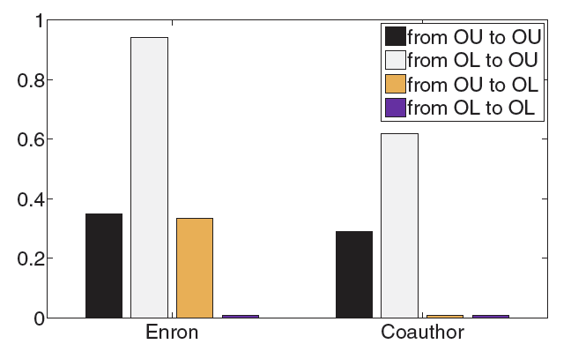
Social Theories—Two-step-flow
Lazarsfeld et al suggested that:
"ideas often flow from radio and print to the opinion leaders and from them to the less active sections of the population."
Estimate OL and OU by PageRank
OL : Opinion leader;
OU : Ordinary user.
Observations: Opinion leaders are more likely (+71%-84% higher than
chance) to spread information to ordinary users.
Lazarsfeld et al. (1944). The people’s choice: How the voter makes up his mind in a presidential campaign.
Notes:
Probability that two types of users have a directed relationship (from higher social status to lower status, i.e., manager-subordinate relationship in Enron and advisor-advisee relationship in Coauthor). It is clear that opinion leaders (detected by PageRank) are more likely to have a higher social-status than ordinary users

Slide 13
Computational Foundations
Social Theories
  Social balance
  Social status
  Structural holes
  Two-step flow
Algorithmic Foundations
  Network flow
  K-densest subgraph
  Set cover

Slide 14
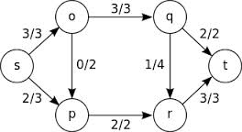
Algorithm — Network Flow
Classical problems:
  Maximum flow / minimum cut
    Ford-Fulkerson algorithm
    Dinic algorithm
  Minimum cut between multiple sets of vertices
    NP hard when there are more than 2 sets
  Minimum cost flow;
  Circulation problem;
  …
Notes:
In circulation problem, each link has a lower bound and upper bound on its flow.

Slide 15
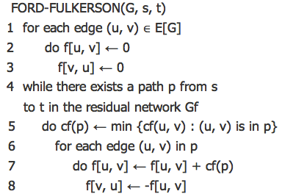
Algorithm — Network Flow (cont.)
Ford-Fulkerson
  As long as there is an augmenting path, send the minimum of the residual capacities on the path.
  A maximum flow is obtained when no augmenting paths left.
  Time complexity: O(VE^2)
Notes:
在剩余网络中寻找一条增广链，进行增广操作，即在增光链中加入不超出任何一条边容量的最大流量，之后更新剩余网络，如此重复直至剩余网络中无增广链存在

Slide 16
Algorithm — K-densest subgraph
NP Problem
  Find the maximum density subgraph on exactly k vertices.
  Reduced from the clique problem
Application
  Reduce the structural hole spanner detection problem to proof its NP hardness.
  To find a subset of nodes, such that without them, the connection between communities would be minimized.

Slide 17
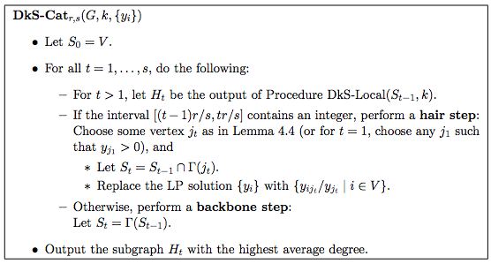
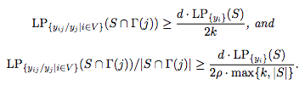
Algorithm — K-densest subgraph (cont.)
A linear programming based solution
  Approximation ratio:
Find the subgraph with the largest average degree in subgraph S_{t-1}
Find j which satisfy:
Update S by j’s neighbors.
Replace S_{t} by neighbors of S_{t-1}
Notes:
对输入的图G，维护一个G的子图S，初始化时另S=G，并从中找出平均度最高的子图。之后寻找一个满足一组线性不等式的结点J，并更新子图S，以得到一个更高的目标函数下界。若J不存在，则将子图S更新为当前子图的所有邻居结点集合。在新子图S中重复上述步骤。
An extension version of the algorithm is able to approximate within O(n^1/4-c), where c is a constant parameter of the algorithm (number of vertices picked up for each leaf)

Slide 18
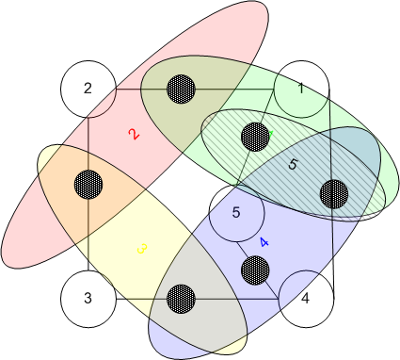

Algorithm — Set Cover
Another NP problem
  Given a set of elements (universe) and a set S of n sets whose union equals the universe;
  Find the smallest subset of S that contains all elements in the universe;
  The decision version is NP-complete.
Greedy
  Choose the set containing the most uncovered elements;
  Approximation ratio: H(size(S)), where H(n) is the n-th harmonic number.
Notes:
H(n) = \sum_{k=1}^{n} 1/k <= ln n + 1

Slide 19
Social Network Analysis
Macro Level
Meso Level
Micro Level

Slide 20
Erdős–Rényi Model
In the G(n, p) model, each edge is included in the graph with probability p independent from every other edge.
Each random graph has the probability
Properties
Degree distribution-Poisson
Clustering coefficient
Average shortest path
Small
Problem: In real social network, neighbors tend to be connected with each other, thus the clustering coefficient should not be too small.
Erdős, P.; Rényi, A. (1959), “On Random Graphs.”.
Notes:
Paul Erdős and Alfréd Rényi,
Hungarian mathematician, Wolf Prize (1983/84)
AMS Cole Prize (1951)

Slide 21
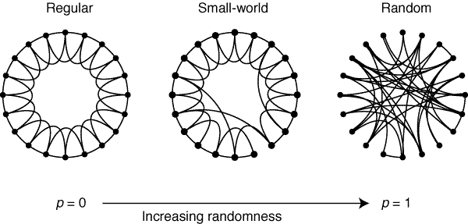
Small-World Model
Mechanism
Start from a regular wired ring, where each node is connected with its K-nearest neighbors
With probability p rewire each edge.
Properties
Degree distribution
Clustering coefficient
Average shortest path
Not power law
Problem: In real social network, degree distribution is power law.
Watts, D. J.; Strogatz, S. H. (1998). "Collective dynamics of 'small-world' networks". Nature 393 (6684): 440–442.
Source: Watts and Strogatz (1998). "Collective dynamics of 'small-world' networks”.

Slide 22

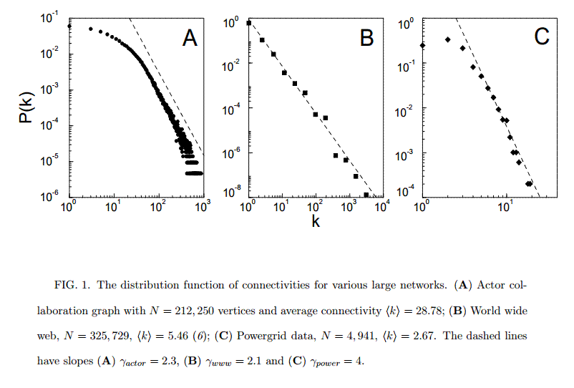
Barabási-Albert Model
Idea
Growth
Preferential attachment (rich-get-richer, the Matthew Effect)
Mechanism
Start from a small connected graph with m₀ nodes
At each time step, add one new node with m ( m ≤ m₀) new edges; the probability that the new node is connected to node i is p_{i} =
Degree distribution
Clustering coefficient
Average longest shortest path
Scale-free
Barabasi and Albert(1999). Emergence of scaling n complex networks.
Source: Barabasi and Albert(1999). Emergence of scaling n complex networks.
Notes:
t时刻加入一个新点，然后算t时刻的clustering coefficient。t很大的时候，可以忽略初始点数，直接看做等于N

Slide 23
Social Network Analysis
Macro Level
Meso Level
Micro Level

Slide 24
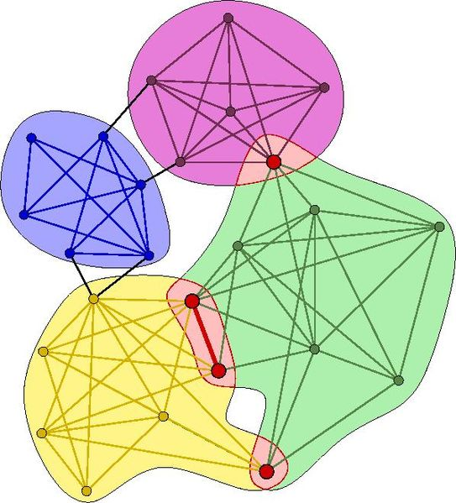
Community Detection
Node-Centric Community
  Each node in a group satisfies certain properties
Group-Centric Community
  Consider the connections within a group as a whole. The group has to satisfy certain properties without zooming into node-level
Network-Centric Community
  Partition the whole network into several disjoint sets
Hierarchy-Centric Community
  Construct a hierarchical structure of communities

Slide 25
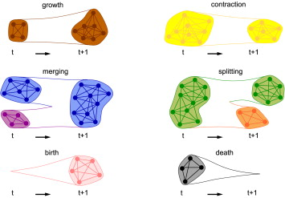
Community Evolution

Slide 26
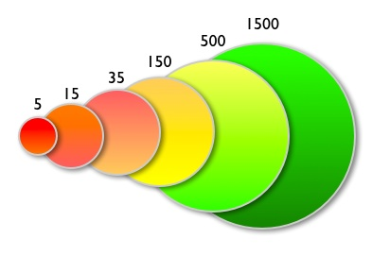
Dunbar Number
Dunbar number:150. Dunbar's number is a suggested cognitive limit to the number of people with whom one can maintain stable social relationships
—Robin Dunbar, 2000

Slide 27
Social Network Analysis
Macro Level
Meso Level
Micro Level

Slide 28


Social Action
…the object is to interpret the meaning of social action and thereby give a causal explanation of the way in which the action proceeds and the effects which it produces...
— Social Action Theory, by Max Weber, 1922
Notes:
Weber is often cited, with Émile Durkheim and Karl Marx, as among the three founding architects of sociology.
Weber was a key proponent of methodological antipositivism, arguing for the study of social action through interpretive (rather than purely empiricist) means, based on understanding the purpose and meaning that individuals attach to their own action

Slide 29

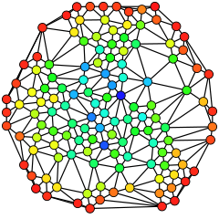
Social Action — User Characterization
Betweenness
  A centrality measure of a vertex within a graph
#shortest paths pass through v
#shortest paths from s to t
Hue (from red=min to blue=max) shows the node betweenness.

Slide 30

Social Action — User Characterization (cont.)
Clustering Coefficient
  A measure of degree to which nodes in a graph tend to cluster together.
  Global clustering coefficient
    A triangle consists of three closed triplets, and a closed triplet consists of three nodes connected to each other.
  Local clustering coefficient

Slide 31

Social Action — User Characterization (cont.)
Degree: the number of one vertex’s neighbors.
Closeness: the shortest path between one vertex and another vertex.

Slide 32
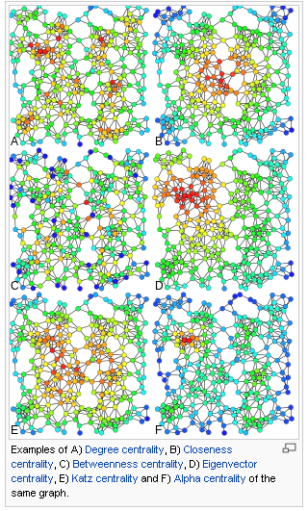
Social Action — User Characterization (cont.)
Centrality

Slide 33
Social Action — Game Theory
Example: a game theory model.
  Strategy: whether to follow a user or not;
  Payoff:
  The model has a pure strategy Nash Equilibrium
The value of a user
The density of v’s ego network
The frequency of a user to follow someone
The cost of following a user
Notes:
一名用户的价值（G）正比于其粉丝数，反比于他follow的人的个数
C_2: 关注对象的ego network越密集，说明其粉丝间联系越多，关注这个人越可能吸引更多回粉

Slide 34
Social Action — Game Theory (cont.)
Results: three stage life cycle
  Stage 1: getting into a community
  Stage 2: becoming an elite
  Stage 3: bridging different communities (structural hole spanners)

Slide 35
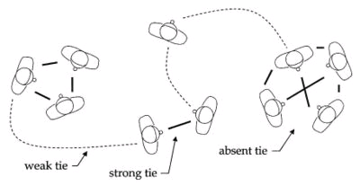
Strong/Weak Ties
Strong ties
  Frequent communication, but ties are redundant due to high clustering
Weak ties
  Reach far across network, but communication is infrequent…
“forbidden triad”:
strong ties are likely to “close”
Weak ties act as local bridge

Slide 36



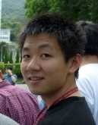
Social Ties
Family
?
Inferring social ties
Friend
?
Reciprocity
You
Lady Gaga
You
Lady Gaga
Triadic Closure
You
You
?
Lady Gaga
Shiteng
Lady Gaga
Shiteng
KDD 2010, PKDD 2011 (Best Paper Runnerup), WSDM 2012, ACM TKDD

Slide 37
Triadic Closure
Follower diffusion
Followee diffusion
A
A
A
A
A
A
t
t
t
t
t
t
B
C
B
C
B
C
B
C
B
t'
C
B
t'
C
t'
t'
t'
t'
A
A
A
A
A
A
t
t
t
t
t
t
B
t'
C
B
C
B
t'
C
B
t'
C
B
C
B
t'
C
t'
t'
A
A
A
A
A
A
t
t
t
t
t
t
B
C
B
t'
C
B
t'
C
B
C
B
t'
C
B
t'
C
t'
t'
A
A
A
A
A
A
t
t
t
t
t
t
B
C
B
C
B
C
B
t'
C
B
C
B
t'
C
t'
t'
t'
t'
12 triads
12 triads

Slide 38
Information Diffusion

Slide 39
Disease-Propagation Models
Classical disease-propagation models in epidemiology are based upon the cycle of disease in a host.
  Susceptible
  Infected
  Recovered
  …
The transition rates from one cycle to another are expressed as derivatives.
Classical models:
  SIR
  SIS
  SIRS
  …

Slide 40


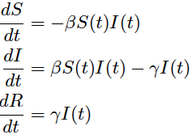
SIR Model
Created by Kermack and McKendrick in 1927.
Considers three cycles of disease in a host:
Transition rates:
S(t) : #susceptible people at time t;
I(t) : #infected people at time t;
R(t) : #recovered people at time t;
: a parameter for infectivity;
: a parameter for recovery.

Slide 41



SIS Model
Designed for infections confer no long lasting immunity (e.g., common cold)
Individuals are considered become susceptible again after infection:
Model:
Notice for both SIR and SIS, it holds:
where N is the fixed total population.
Notes:
Some infections, for example the group of those responsible for the common cold, do not confer any long lasting immunity. Such infections do not have a recovered state and individuals become susceptible again after infection.

Slide 42
Core Research in Social Network
Application
Prediction
Search
Information Diffusion
Advertise
Macro
Meso
Micro
Social Network Analysis
BA model
ER model
Community
Group behavior
Dunbar
Social tie
Action
Social influence
Theory
Social Theories
Algorithmic Foundations
BIG Social Data

Slide 43
Social Influence Analysis

Slide 44
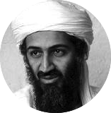






“Love Obama”
I love Obama
I hate Obama, the worst president ever
Obama is fantastic
Obama is great!
No Obama in 2012!
He cannot be the next president!
Positive
Negative
Notes:
Obama has done just that. From social networking to his blog to his Fight the Smears campaign, Obama has made his Web 2.0 presence known. He has over 1.5 million friends on MySpace and Facebook, and he currently has over 28,000,000 followers on Twitter. This personal activity in social networks allows him to quickly get the word out across multiple platforms.

Slide 45
What is Social Influence?
Social influence occurs when one's opinions, emotions, or behaviors are affected by others, intentionally or unintentionally.^{[1]}
  Informational social influence: to accept information from another;
  Normative social influence: to conform to the positive expectations of others.
[1] http://en.wikipedia.org/wiki/Social_influence

Slide 46
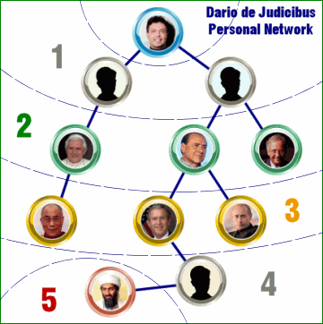

Three Degree of Influence
Six degree of separation^{[1]}
Three degree of Influence^{[2]}
You are able to influence up to >1,000,000 persons in the world, according to the Dunbar’s number^{[3]}.
[1] S. Milgram. The Small World Problem. Psychology Today, 1967, Vol. 2, 60–67
[2] J.H. Fowler and N.A. Christakis. The Dynamic Spread of Happiness in a Large Social Network: Longitudinal Analysis Over 20 Years in the Framingham Heart Study. British Medical Journal 2008; 337: a2338
[3] R. Dunbar. Neocortex size as a constraint on group size in primates. Human Evolution, 1992, 20: 469–493.

Slide 47
Challenges: WH³
Whether social influence exist?
How to measure influence?
How to model influence?
How influence can help real applications?

Slide 48
Preliminaries

Slide 49





Notations
Time t
Node/user: v_{i}
Time t-1, t-2…
Attributes: x_{i}
- location, gender, age, etc.
Action/Status: y_{i}
- e.g., “Love Obama”
G =(V, E, X, Y)
G^{t} — the superscript t represents the time stamp
— represents a link/relationship from v_{i} to v_{j} at time t

Slide 50
Homophily
Homophily
  A user in the social network tends to be similar to their connected neighbors.
Originated from different mechanisms
  Social influence
    Indicates people tend to follow the behaviors of their friends
  Selection
    Indicates people tend to create relationships with other people who are already similar to them
  Confounding variables
    Other unknown variables exist, which may cause friends to behave similarly with one another.

Slide 51
Influence and Selection^{[1]}
Similarity between user i and j at time t-1 is larger than a threshold
Denominator: the conditional probability that an unlinked pair will become linked
Numerator: the same probability for unlinked pairs whose similarity exceeds the threshold
Denominator: the probability that the similarity increase from time t-1 to time t between two nodes that were not linked at time t-1
Numerator: the same probability that became linked at time t
A Model is learned through matrix factorization/factor graph
There is a link between user i and j at time t
[1] J. Scripps, P.-N. Tan, and A.-H. Esfahanian. Measuring the effects of preprocessing decisions and network forces in dynamic network analysis. In KDD’09, pages 747–756, 2009.
Notes:
Matrix alignment framework
Learn the weight of different attributes for establishing relationships between users
The diagonal elements of W correspond to the vector of weights of attributes

Slide 52
Other Related Concepts
Cosine similarity
Correlation factors
Hazard ratio
t-test

Slide 53
Cosine Similarity
A measure of similarity
Use a vector to represent a sample (e.g., user)
To measure the similarity of two vectors x and y, employ cosine similarity:

Slide 54
Correlation Factors
Several correlation coefficients could be used to measure correlation between two random variables x and y.
Pearsons’ correlation
It could be estimated by
Note that correlation does NOT imply causation
mean
Standard deviation
Notes:
Correlation between variables is a measure of how well the variables are related. The most common measure of correlation in statistics is the Pearson Correlation

Slide 55
Hazard Ratio
Hazard Ratio
  Chance of an event occurring in the treatment group divided by its chance in the control group
  Example:
  Chance of users to buy iPhone with >=1 iPhone user friend(s)
  Chance of users to buy iPhone without any iPhone user friend
  Measuring instantaneous chance by hazard rate h(t)
  The hazard ratio is the relationship between the instantaneous hazards in two groups
  Proportional hazards models (e.g. Cox-model) could be used to report hazard ratio.
Notes:
Survival analysis is a branch of statistics which deals with death in biological organisms and failure in mechanical systems.
hazard ratio can reflect the influence from a user’s friend on the purchase of iPhone.

Slide 56
t-test
A t-test usually used when the test statistic follows a Student’s t distribution if the null hypothesis is supported.
To test if the difference between two variables are significant
Welch’s t-test
  Calculate t-value
  Find the p-value using a table of values from Student’s t-distribution
  If the p-value is below chosen threshold (e.g. 0.01) then the two variables are viewed as significant different.
Unbiased estimator of sample variance
sample mean
#participants in the control group
#participants in the treatment group
Notes:
One-sample t-test
Null hypothesis = the population mean is equal to mu0
Welch’s t-test (equal or unequal mean, unequal variance)

Slide 57
Data Sets

Slide 58
Ten Cases
Network | #Nodes | #Edges | Behavior
Twitter-net | 111,000 | 450,000 | Follow
Weibo-Retweet | 1,700,000 | 400,000,000 | Retweet
Slashdot | 93,133 | 964,562 | Friend/Foe
Mobile (THU) | 229 | 29,136 | Happy/Unhappy
Gowalla | 196,591 | 950,327 | Check-in
ArnetMiner | 1,300,000 | 23,003,231 | Publish on a topic
Flickr | 1,991,509 | 208,118,719 | Join a group
PatentMiner | 4,000,000 | 32,000,000 | Patent on a topic
Citation | 1,572,277 | 2,084,019 | Cite a paper
Twitter-content | 7,521 | 304,275 | Tweet “Haiti Earthquake”
Most of the data sets will be publicly available for research.

Slide 59



Case 1: Following Influence on Twitter
Time 1
Time 2
Lady Gaga
Lady Gaga
Lei
Sen
Lei
Sen
Peng
Peng
When you follow a user in a social network, will the be-
havior influences your friends to also follow her?

Slide 60




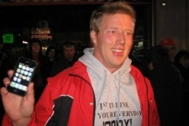


Case 2: Retweeting Influence
Bob
Who will follow to retweet it?
Andy
Dan
Jon
When you (re)tweet something

Slide 61

Case 3: Commenting Influence
News:
Alan Cox Exists Intel.
Governments Want Private Data
Re:…
+ Friend
- Foe
-
-
Re:…
Re:…
Re:…
+
-
+
+
Re:…
-
Did not comment
Re:…
Re:…
negative influence from foes
positive influence from friends

Slide 62
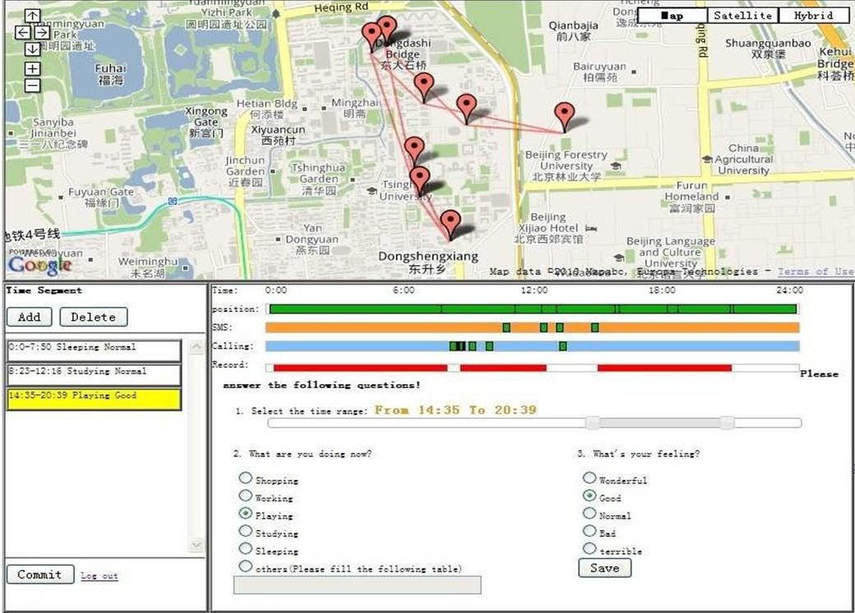
Case 4: Emotion Influence
SMS & Calling
Location
Activities
Emotion?

Slide 63
Case 4: Emotion Influence (cont.)
Can we predict users’ emotion?

Slide 64

Case 5: Check-in Influence in Gowalla
Legend
Alice
Alice’s friend
Other users
1’
1’
1’
1’
If Alice’s friends check in this location at time t
Will Alice also check in nearby?

Slide 65
Understanding the Emotional Impact in Social Networks
[1] J. Jia, S. Wu, X. Wang, P. Hu, L. Cai, and J. Tang. Can We Understand van Gogh’s Mood? Learning to Infer Affects from Images in Social Networks. In ACM Multimedia, pages 857-860, 2012.

Slide 66
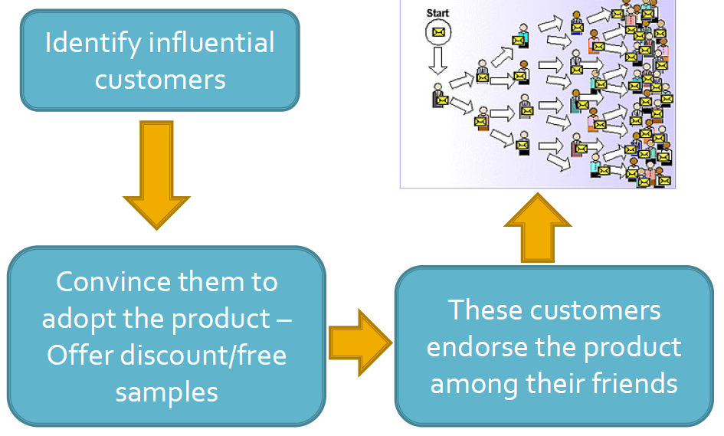
The model of Viral Marketing

Slide 67

Influence Maximization
Influence maximization
  Minimize marketing cost and more generally to maximize profit.
  E.g., to get a small number of influential users to adopt a new product, and subsequently trigger a large cascade of further adoptions.
Probability of influence
B
A
0.8
C
0.5
0.1
0.4
0.6
0.1
0.6
D
E
F
0.1
[1] P. Domingos and M. Richardson. Mining the network value of customers. In Proceedings of the seventh ACM SIGKDD international conference on Knowledge discovery and data mining (KDD’01), pages 57–66, 2001.
Notes:
The problem of influence maximization can be traced back to the research on “word-of-mouth” and “viral marketing

Slide 68
Problem Abstraction
We associate each user with a status:
  Active or Inactive
  The status of the chosen set of users (seed nodes) to market is viewed as active
  Other users are viewed as inactive
Influence maximization
  Initially all users are considered inactive
  Then the chosen users are activated, who may further influence their friends to be active as well

Slide 69
Diffusion Influence Model
Linear Threshold Model
Cascade Model

Slide 70
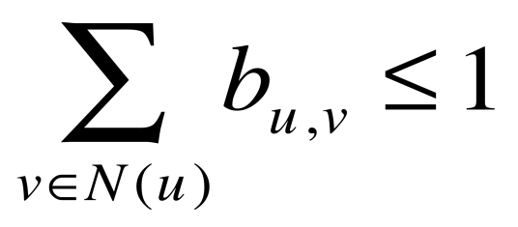
Linear Threshold Model
General idea
  Whether a given node will be active can be based on an arbitrary monotone function of its neighbors that are already active.
Formalization
  f_{v} : map subsets of v’s neighbors’ influence to real numbers in [0,1]
  θ_{v} : a threshold for each node
  S: the set of neighbors of v that are active in step t-1
  Node v will turn active in step t if f_{v}(S) >θ_{v}
Specifically, in [Kempe, 2003], f_{v} is defined as , where b_{v,u} can be seen as a fixed weight, satisfying
[1] D. Kempe, J. Kleinberg, and E. Tardos. Maximizing the spread of influence through a social network. In Proceedings of the ninth ACM SIGKDD international conference on Knowledge discovery and data mining (KDD’03), pages 137–146, 2003.

Slide 71

Linear Threshold Model: An example
A
1st try, 0.7>0.5
B
0.3
0.7
0.74
0.2
1st try
0.74<0.8
0.4
0.1
0.05
0.5
2nd try, 0.74+0.1>0.8
0.1
C

Slide 72
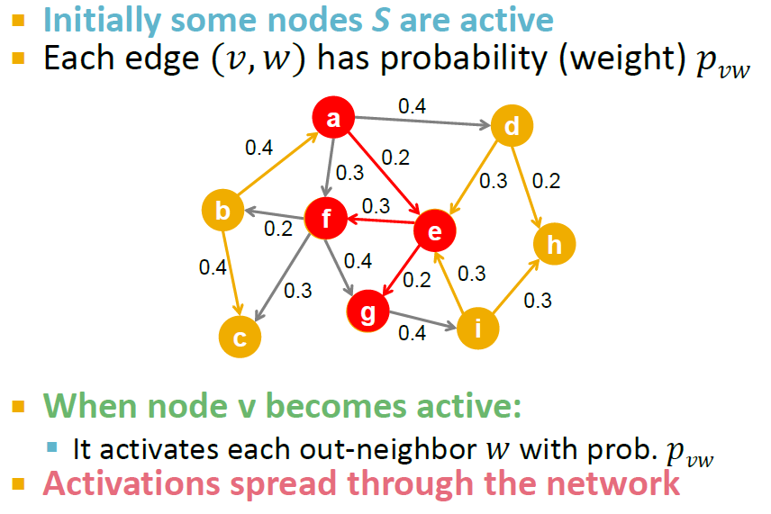
Independent Cascade model

Slide 73
Cascade Model
Cascade model
  p_{v}(u,S) : the success probability of user u activating user v
  User u tries to activate v and finally succeeds, where S is the set of v’s neighbors that have already attempted but failed to make v active
Independent cascade model
  p_{v}(u,S) is a constant, meaning that whether v is to be active does not depend on the order v’s neighbors try to activate it.
  Key idea: Flip coins c in advance -> live edges
  F_{c}(A): People influenced under outcome c (set cover)
  F(A) = Sum _{c}P(c) F_{c}(A) is submodular as well
[1] D. Kempe, J. Kleinberg, and E. Tardos. Maximizing the spread of influence through a social network. In Proceedings of the ninth ACM SIGKDD international conference on Knowledge discovery and data mining (KDD’03), pages 137–146, 2003.

Slide 74
Theoretical Analysis
NP-hard [1]
  Linear threshold model
  General cascade model
Kempe Prove that approximation algorithms can guarantee that the influence spread is within(1-1/e) of the optimal influence spread.
  Verify that the two models can outperform the traditional heuristics
Recent research focuses on the efficiency improvement
  [2] accelerate the influence procedure by up to 700 times
It is still challenging to extend these methods to large data sets
[1] D. Kempe, J. Kleinberg, and E. Tardos. Maximizing the spread of influence through a social network. In Proceedings of the ninth ACM SIGKDD international conference on Knowledge discovery and data mining(KDD’03), pages 137–146, 2003.
[2] J. Leskovec, A. Krause, C. Guestrin, C. Faloutsos, J. VanBriesen, and N. Glance. Cost-effective outbreak detection in networks. In Proceedings of the 13th ACM SIGKDD international conference on Knowledge discovery and data mining (KDD’07), pages 420–429, 2007.

Slide 75


Objective Function
Objective function:
- f (S) = Expected #people influenced when targeting a set of users S
Define f (S) as a monotonic submodular function
where
[1] P. Domingos and M. Richardson. Mining the network value of customers. In Proceedings of the seventh ACM SIGKDD international conference on Knowledge discovery and data mining (KDD’01), pages 57–66, 2001.
[2] D. Kempe, J. Kleinberg, and E. Tardos. Maximizing the spread of influence through a social network. In Proceedings of the ninth ACM SIGKDD international conference on Knowledge discovery and data mining(KDD’03), pages 137–146, 2003.

Slide 76
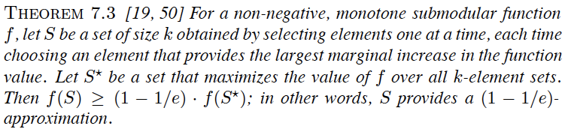
Maximizing the Spread of Influence
Solution
  Use a submodular function to approximate the influence function
  Then the problem can be transformed into finding a k-element set S for which f (S) is maximized.
approximation ratio
[1] D. Kempe, J. Kleinberg, and E. Tardos. Maximizing the spread of influence through a social network. In Proceedings of the ninth ACM SIGKDD international conference on Knowledge discovery and data mining (KDD’03), pages 137–146, 2003.
Notes:
Thus, the problem can be transformed into finding a k-element set S for which f(S) is maximized. The problem, can be solved using a greedy hill-climbing algorithm which approximates the optimal solution within a factor of (1 − 1/e). The following theorem formally defines the problem
The model can be further extended to assume that each node v has an associated non-negative weight wv, which can be used to capture the human prior knowledge to the task at hand, e.g., how important it is that v be activated in the final outcome.

Slide 77

Performance Guarantee
Let be the -th node selected by the greedy algorithm
Let and
For and
Let
where is the optimal solution
We have
Thus
Then
Recall
monotonicity
greedy + submodularity
The solution obtained by Greedy is better than 63% of the optimal solution

Slide 78
Algorithms
General Greedy
Low-distance Heuristic
High-degree heuristic
Degree Discount Heuristic

Slide 79
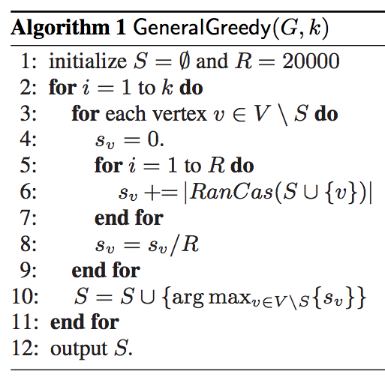
General Greedy
General idea: In each round, the algorithm adds one vertex into the selected set S such that this vertex together with current set S maximizes the inﬂuence spread.
Any random diffusion process

Slide 80
Low-distance Heuristic
Consider the nodes with the shortest paths to other nodes as seed nodes
Intuition
  Individuals are more likely to be influenced by those who are closely related to them.
Notes:
Another commonly used influence measure in sociology is distance centrality, which considers the nodes with the shortest paths
to other nodes as be seed nodes. This strategy is based on the intuition that individuals are more likely to be influenced by those who are closely related to them

Slide 81
High-degree heuristic
Choose the seed nodes according to their degree.
Intuition
  The nodes with more neighbors would arguably tend to impose more influence upon its direct neighbors.
  Know as “degree centrality”
Notes:
It chooses the seed nodes according to their degree dv. The strategy is very simple but also natural because the nodes with more
neighbors would arguably tend to impose more influence upon its direct neighbors. This consideration of high-degree nodes is also known in the sociology literature as “degree centrality”

Slide 82
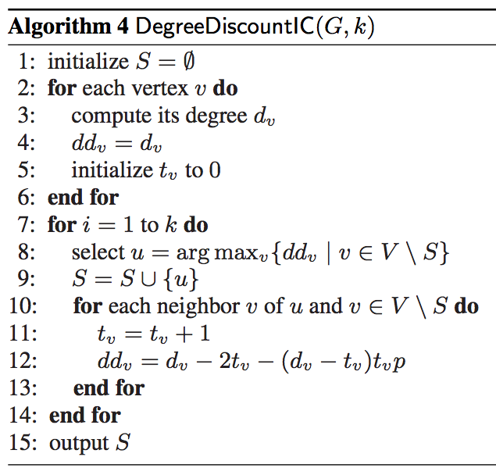
Degree Discount Heuristic^{[1]}
General idea: If u has been selected as a seed, then when considering selecting v as a new seed based on its degree, we should not count the edge v->u
Specifically, for a node v with d_{v} neighbors of which t_{v} are selected as seeds, we should discount v’s degree by
2t_{v} +(d_{v}-t_{v}) t_{v} p
where p=0.1.
[1] W. Chen, Y. Wang, and S. Yang. Efficient influence maximization in social networks. In KDD'09, pages 199-207, 2009.
Notes:
The general idea of this approach is that if u has been selected as a seed, then when considering selecting v as a new seed based
on its degree, we should not count the edge vu towards its degree. This is referred to as SingleDiscount. More specifically, for a node v with dv neighbors of which tv are selected as seeds already, we should discount v’s degree by

Slide 83
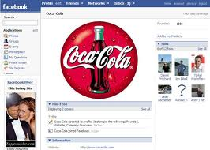
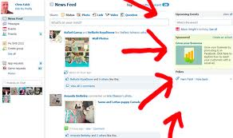
Social Influence
Applications
Social Influence
Test
Measure
Models
1
2
3

Slide 84
Application: Social Advertising^{[1]}
Conducted two very large field experiments that identify the effect of social cues on consumer responses to ads on Facebook
Exp. 1: measure how responses increase as a function of the number of cues.
Exp. 2: examines the effect of augmenting traditional ad units with a minimal social cue
Result: Social influence causes significant increases in ad performance
[1] E. Bakshy, D. Eckles, R. Yan, and I. Rosenn. Social influence in social advertising: evidence from field experiments. In EC'12, pages 146-161, 2012.

Slide 85
Application: Opinion Leader^{[1]}
Propose viral marketing through frequent pattern mining.
Assumption
  Users can see their friends actions.
Basic formation of the problem
  Actions take place in different time steps, and the actions which come up later could be influenced by the earlier taken actions.
Approach
  Define leaders as people who can influence a sufficient number of people in the network with their actions for a long enough period of time.
  Finding leaders in a social network makes use of action logs.
[1] A. Goyal, F. Bonchi, and L. V. Lakshmanan. Discovering leaders from community actions. In CIKM’08, pages 499–508, 2008.
Notes:
Social influence analysis techniques can also be leveraged for online advertising

Slide 86
Application: Influential Blog Discovery^{[1]}
Influential Blog Discovery
  In the web 2.0 era, people spend a significant amount of time on user-generated content web sites, like blog sites.
  Opinion leaders bring in new information, ideas, and opinions, and disseminate them down to the masses.
Four properties for each bloggers
  Recognition: A lot of inlinks to the article.
  Activity generation: A large number of comments indicates that the blog is influential.
  Novelty: with less outgoing links.
  Eloquence: Longer articles tend to be more eloquent, and can thus be more influential.
[1] N. Agarwal, H. Liu, L. Tang, and P. S. Yu. Identifying the influential bloggers in a community. In WSDM’08, pages 207–217, 2008.
Notes:
In the web 2.0 era, people spend a significant amount of time on user-generated content web sites, a classic example of which are blog sites. People form an online social network by visiting other users’ blog posts. Some of the blog users bring in new information, ideas, and opinions, and disseminate them down to the masses.
The work presents a model which takes advantages of the above four properties to describe the influence flow in the influence-graph consisting of all the blogger pages. Basically, the influence flow probability is defined as follows

Slide 87
Submodular functions and their applications

Slide 88
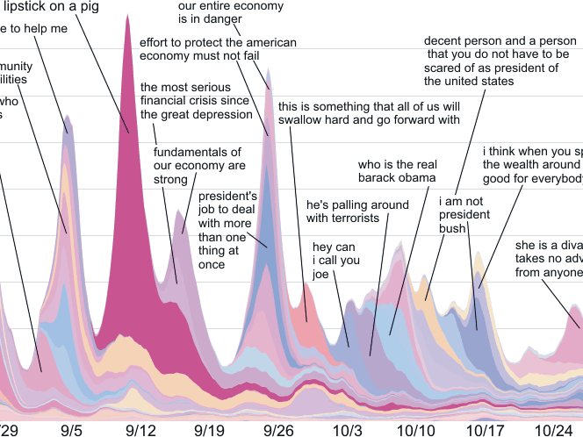
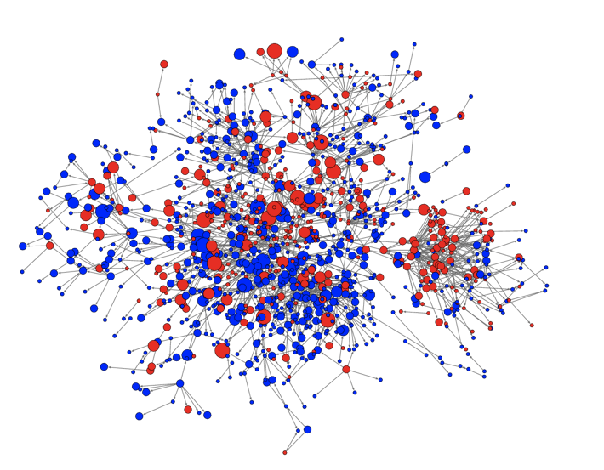
Network Inference
How learn who influences whom?

Slide 89

Summarizing Documents
How select representative sentences?

Slide 90
MAP (Maximum A-Posteriori) inference
sky
tree
house
grass
How find the MAP labeling in discrete graphical models
efficiently?

Slide 91
What’s common?
Formalization:
Optimize a set function F(S) under constraints
generally very hard
but: structure helps!
… if F is submodular, we can …
  solve optimization problems with strong guarantees
  solve some learning problems

Slide 92
Outline
many new
results! ☺
What is submodularity?
Optimization
  Minimization
  Maximization
Learning
Learning for Optimization: new settings
Part I
Part II

Slide 93
Outline
many new
results! ☺
What is submodularity?
Optimization
  Minimization: new algorithms, constraints
  Maximization: new algorithms (unconstrained)
Learning
Learning for Optimization: new settings
Part I
Part II
… and many new applications!

Slide 94
submodularity.org
slides, links, references, workshops, …

Slide 95


Example: placing sensors
Place sensors to monitor temperature

Slide 96


Set functions
finite ground set
set function
will assume (w.l.o.g.)
assume black box that can evaluate
for any

Slide 97

Example: placing sensors
Utility of having sensors at subset of all locations
X₄
X₁
X₃
X₁
X₅
X₂
A={1,2,3}: Very informative
High value F(A)
A={1,4,5}: Redundant info
Low value F(A)

Slide 98

Marginal gain
Given set function
Marginal gain:
X₁
X₂
X_{s}
new sensor s

Slide 99
Decreasing gains: submodularity
placement A = {1,2}
placement B = {1,…,5}
X₁
X₂
X₂
X₁
X₃
X₄
X₅
Big gain
Adding s helps a lot!
X_{s}
Adding s doesn’t help much
small gain
new sensor s
+ s
A
B
+ s

Slide 100
Equivalent characterizations
Diminishing gains: for all
Union-Intersection: for all
A
+ s
B
+ s

Slide 101
Questions
How do I prove my problem is submodular?
Why is submodularity useful?

Slide 102


Example: Set cover
place sensors
in building
goal: cover floorplan with discs
Possible
locations
Node predicts
values of positions
with some radius
:
“area covered by sensors placed at A”
Formally:
Finite set , collection of n subsets
For define

Slide 103
Set cover is submodular
A={s₁,s₂}
S₁
S₂
S’
F(A U {s’}) – F(A)
≥
F(B U {s’}) – F(B)
S₁
S₂
S₃
S₄
S’
B = {s₁,s₂,s₃,s₄}

Slide 104

More complex model for sensing
Y₁
Y₂
Y₃
Y_{s}: temperature
at location s
X₁
X₃
X₂
X_{s}: sensor value
at location s
Y₆
Y₄
Y₅
X₆
X_{s} = Y_{s} + noise
X₄
X₅
Joint probability distribution
P(X₁,…,X_{n},Y₁,…,Y_{n}) = P(Y₁,…,Y_{n}) P(X₁,…,X_{n} | Y₁,…,Y_{n})
Prior
Likelihood

Slide 105
Example: Sensor placement
Utility of having sensors at subset A of all locations
Uncertainty
about temperature Y
before sensing
Uncertainty
about temperature Y
after sensing
X₄
X₁
X₃
X₁
X₅
X₂
A={1,2,3}: High value F(A)
A={1,4,5}: Low value F(A)

Slide 106
Submodularity of Information Gain
Y₁,…,Y_{m}, X₁, …, X_{n} discrete RVs
F(A) = I(Y; X_{A}) = H(Y)-H(Y | X_{A})
F(A) is NOT always submodular
If X_{i} are all conditionally independent given Y,
then F(A) is submodular! [Krause & Guestrin `05]
Y₁
Y₂
Y₃
Proof:
“information never hurts”
X₁
X₂
X₃
X₄
F(A) is always monotone

Slide 107



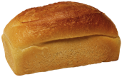

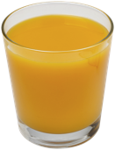




Example: costs
cost:
time to reach shop
+ price of items
Market 3
breakfast??
t₃
ground set
t₁
t₂
Market 1
Market 2
each item
1 $

Slide 108






Example: costs
cost:
time to shop
+ price of items
Market 3
breakfast??
F( ) = cost( ) + cost( , )
= t₁ + 1 + t₂ + 2
= #shops + #items
Market 1
Market 2
submodular?

Slide 109











Shared fixed costs
A
B
marginal cost: #new shops + #new items
decreasing ➔ cost is submodular!
shops: shared fixed cost
economies of scale

Slide 110
Another example: Cut functions
2
1
3
a
c
e
g
V={a,b,c,d,e,f,g,h}
2
3
2
2
2
3
3
3
b
d
f
h
2
1
3
Cut function is submodular!

Slide 111
Why are cut functions submodular?
w
S | F_{ab}(S)
{} | 0
{a} | w
{b} | w
{a,b} | 0
a
b
2
1
3
a
c
e
g
2
3
2
2
2
3
3
3
Submodular if
w ≥ 0!
b
d
f
h
2
1
3
Cut function in subgraph {i,j}
➔ Submodular!
Restriction: still submodular

Slide 112
Closedness properties
F₁,…,F_{m} submodular functions on V and λ₁,…,λ_{m} > 0
Then: F(A) = ∑_{i} λ_{i} F_{i}(A) is submodular
Submodularity closed under nonnegative linear combinations!
Extremely useful fact:
  F_{θ}(A) submodular ➔ ∑_{θ} P(θ) F_{θ}(A) submodular!
  Multicriterion optimization
  A basic proof technique! ☺

Slide 113
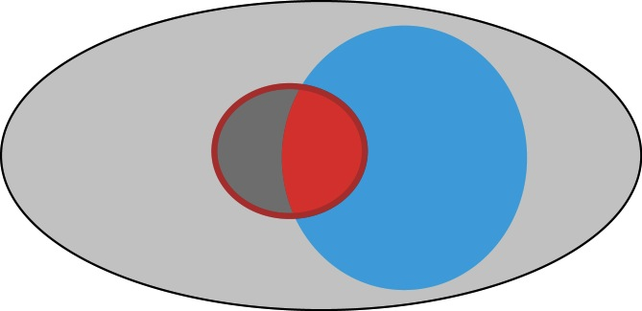
Other closedness properties
Restriction: F(S) submodular on V, W subset of V
Then is submodular
S
V
W

Slide 114
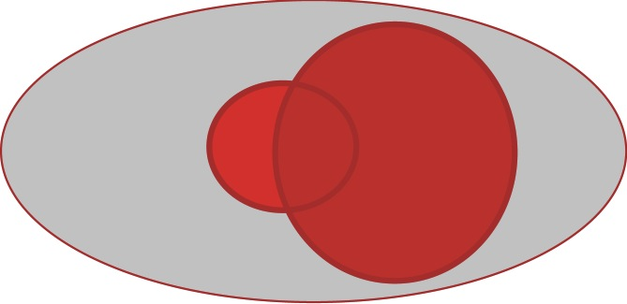
Other closedness properties
Restriction: F(S) submodular on V, W subset of V
Then is submodular
Conditioning: F(S) submodular on V, W subset of V
Then is submodular
S
V
W

Slide 115
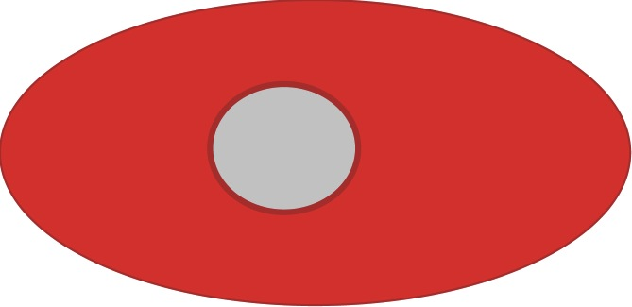
Other closedness properties
Restriction: F(S) submodular on V, W subset of V
Then is submodular
Conditioning: F(S) submodular on V, W subset of V
Then is submodular
Reflection: F(S) submodular on V
Then is submodular
S
V

Slide 116
Submodularity …
discrete convexity ….
… or concavity?

Slide 117
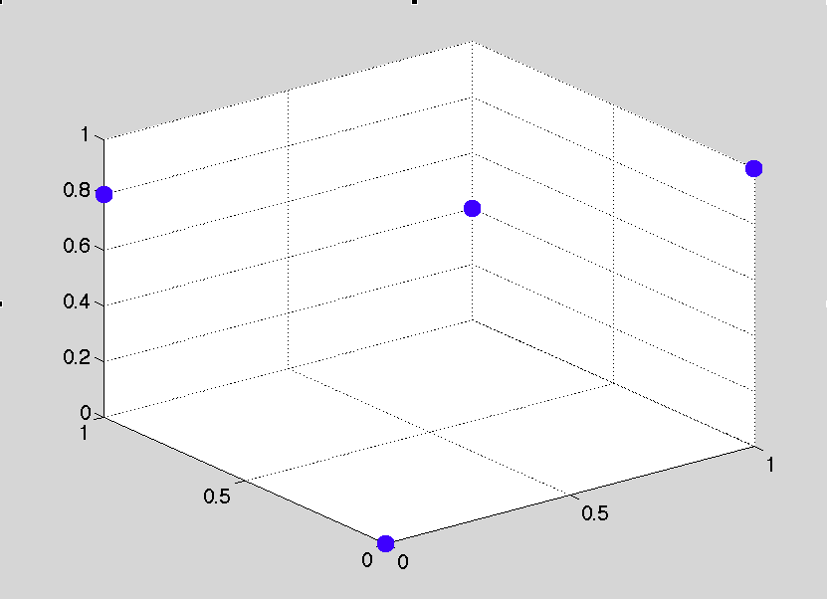
Convex aspects
convex extension
  duality
  efficient minimization
But this is only
half of the story…

Slide 118
Concave aspects
submodularity:
concavity:
A
+ s
B
+ s
F(A) “intuitively”
|A|

Slide 119
Submodularity and concavity
suppose and
submodular if and only if …
is concave

Slide 120
Maximum of submodular functions
submodular. What about
?
F(A) = max(F₁(A),F₂(A))
F₁(A)
F₂(A)
|A|
max(F₁,F₂) not submodular in general!

Slide 121
Minimum of submodular functions
Well, maybe F(A) = min(F₁(A),F₂(A)) instead?
 | F₁(A) | F₂(A) | F(A)
{} | 0 | 0 | 0
{a} | 1 | 0 | 0
{b} | 0 | 1 | 0
{a,b} | 1 | 1 | 1
F({b}) – F({})=0
<
F({a,b}) – F({a})=1
min(F₁,F₂) not submodular in general!

Slide 122

Two faces of submodular functions
Convex aspects
➔minimization!
Concave aspects
➔maximization!
Convex aspects
  Useful for minimization
  Convex extension
Concave aspects
  Useful for maximization
  Multilinear extension
Not closed under
minimum and maximum

Slide 123
What to do with submodular functions
Optimization
Learning
Minimization
Online/
adaptive
optim.
Maximization

Slide 124
What to do with submodular functions
Optimization
Learning
Minimization
Online/
adaptive
optim.
Maximization
Minimization and maximization not the same??

Slide 125
Submodular minimization
clustering
structured sparsity
regularization
s
t
MAP inference
minimum cut

Slide 126
Submodular minimization
➔ submodularity and convexity

Slide 127
Set functions and energy functions
any set function
with .
… is a function on
binary vectors!
A
1
a
a
1
b
b
0
c
c
0
d
d
pseudo-boolean function

Slide 128
Submodularity and convexity
extension
minimum of f is a minimum of F
submodular minimization as convex minimization:
polynomial time! Grötschel, Lovász, Schrijver 1981
Lovász extension
convex
Lovász, 1982

Slide 129
Submodularity and convexity
extension
minimum of f is a minimum of F
submodular minimization as convex minimization:
polynomial time!
Lovász extension
convex
Lovász, 1982

Slide 130
The submodular polyhedron P_{F}
Example: V = {a,b}
A | F(A)
{} | 0
{a} | -1
{b} | 2
{a,b} | 0
x_{{b}}
2
x({b}) ≤ F({b})
P_{F}
1
x({a,b}) ≤ F({a,b})
-2
-1
0
1
x_{{a}}
x({a}) ≤ F({a})

Slide 131
Evaluating the Lovász extension
Linear maximization over P_{F}
Exponentially many constraints!!! ☹
Computable in O(n log n) time ☺
[Edmonds ‘70]
y*
x_{{b}}
2
x
1
-2
-1
0
1
x_{{a}}
Subgradient
Separation oracle
greedy algorithm:
sort x
order defines sets

Slide 132
Lovász extension: example
F(a)
F(b)
A | F(A)
{} | 0
{a} | 1
{b} | .8
{a,b} | .2
F(a,b)
F({})

Slide 133
Submodular minimization
minimize convex extension
ellipsoid algorithm
[Grötschel et al. `81]
subgradient method,
smoothing [Stobbe & Krause `10]
duality: minimum norm point algorithm
[Fujishige & Isotani ’11]
combinatorial algorithms
Fulkerson prize
Iwata, Fujishige, Fleischer ‘01 & Schrijver ’00
state of the art:
O(n⁴T + n⁵logM) [Iwata ’03]
O(n⁶ + n⁵T) [Orlin ’09]
T = time for evaluating F

Slide 134
The minimum-norm-point algorithm
Example: V = {a,b}
Lovász extension
dual: minimum norm problem
regularized problem
A | F(A)
{} | 0
{a} | -1
{b} | 2
{a,b} | 0
Base polytope B_{F}
u({a,b})=F({a,b})
x_{{b}}
2
u*
minimizes F:
[-1,1]
1
-2
-1
0
1
Fujishige ‘91, Fujishige & Isotani ‘11
x_{{a}}

Slide 135
The minimum-norm-point algorithm
find
can we solve this??
u({a,b})=F({a,b})
x_{{b}}
yes! ☺
recall: can solve
linear optimization over P_{F}
similar: optimization over B_{F}
➔ can find
(Frank-Wolfe algorithm)
2
u*
[-1,1]
1
-2
-1
0
1
x_{{a}}
Fujishige ‘91, Fujishige & Isotani ‘11

Slide 136
Empirical comparison
combinatorial
algorithms
Cut functions
from DIMACS
Challenge
Running time (seconds)
Lower is better (log-scale!)
Minimum norm point
algorithm
64
128
256
512
1024
Problem size (log-scale!)
Minimum norm point algorithm: usually orders of magnitude faster
[Fujishige & Isotani ’11]

Slide 137

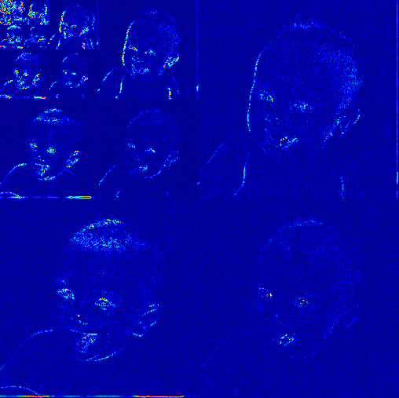
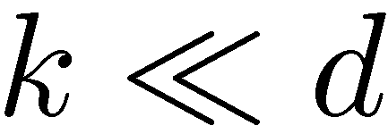

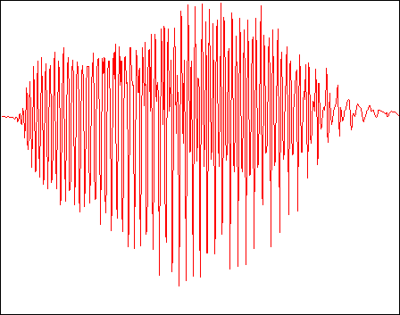
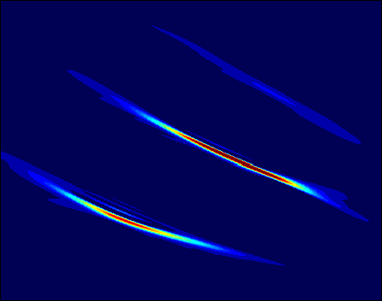

Example: Sparsity
large
wavelet
coefficients
pixels
wideband
signal
samples
large
Gabor (TF)
coefficients
frequency
time
Many natural signals sparse in suitable basis.
Can exploit for learning/regularization/compressive sensing...

Slide 138
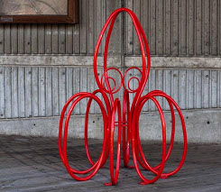

Example: MAP inference
label
pixel
labels
pixel
values

Slide 139
Example: MAP inference
1
1
0
0
1
1
0
0
0
0
0
0
Recall: equivalence
function on binary vectors
set function
A
1
a
a
1
b
b
0
c
if is submodular (attractive potentials), then
MAP inference = submodular minimization!
polynomial-time
c
0
d
d

Slide 140
Special cases
Minimizing general submodular functions:
poly-time, but not very scalable
Special structure ➔ faster algorithms
Symmetric functions
Graph cuts
Concave functions
Sums of functions with bounded support
...

Slide 141
Fast approximate minimization
Not all submodular functions can be optimized as graph cuts
Even if they can: possibly many extra nodes in the graph ☹
Other options?
minimum norm algorithm
other special cases:
e.g. parametric maxflow
[Fujishige & Iwata`99]
speech corpus selection [Lin&Bilmes `11]
Approximate! ☺
Every submodular function
can be approximated by
a series of graph cut
functions [Jegelka, Lin & Bilmes `11]

Slide 142
Fast approximate minimization
Not all submodular functions can be optimized as graph cuts
Even if they can: possibly many extra nodes in the graph ☹
speech corpus selection [Lin&Bilmes `11]
Approximate! ☺
decompose:
represent as much as
possible exactly by a graph
rest: approximate iteratively
by changing edge weights
solve a series of cut problems

Slide 143
Other special cases
Symmetric:
  Queyranne‘s algorithm: O(n³) [Queyranne, 1998]
Concave of modular:
  [Stobbe & Krause `10, Kohli et al, `09]
Sum of submodular functions, each bounded support
[Kolmogorov `12]

Slide 144
Submodular minimization
Optimization
unconstrained
Learning
constrained
Online/
adaptive
optim.
Maximization

Slide 145
Submodular minimization
unconstrained:
  nontrivial algorithms,
  polynomial time
constraints: e.g.
  limited cases doable:
  odd/even cardinality, inclusion/exclusion of a set
special case:
balanced
cut
General case: NP hard
hard to approximate within polynomial factors!
But: special cases often still work well
[Lower bounds: Goel et al.`09, Iwata & Nagano `09, Jegelka & Bilmes `11]

Slide 146
Constraints
minimum…
cut
matching
path
spanning tree
ground set: edges in a graph

Slide 147
Constrained optimization
cut
matching
path
spanning tree
approximate optimization
convex relaxation
minimize surrogate function
approximation bounds dependent on F:
polynomial – constant – FPTAS
[Goel et al.`09, Iwata & Nagano `09, Goemans et al. `09, Jegelka & Bilmes `11, Iyer et al. ICML `13,
Kohli et al `13...]

Slide 148
Submodular min in practice
Does a special algorithm apply?
  symmetric function? graph cut? …. approximately?
Continuous methods: convexity
  minimum norm point algorithm
Other techniques [not addressed here]
  LP, column generation, …
Combinatorial algorithms: relatively high complexity
Constraints: hard
  majorize-minimize or relaxation

Slide 149
Optimization
Optimization
Minimization
Learning
Online/
adaptive
optim.
Maximization

Slide 150



Submodular maximization
.
.
.
X₄
.
.
.
.
.
.
X₁
.
.
X₂
X₅
covering
sensing
summarization
network inference

Slide 151
Two faces of submodular functions
Convex aspects
➔minimization!
Concave aspects
➔maximization!
Convex aspects
  Useful for minimization
  Convex extension
Concave aspects
  Useful for maximization
  Multilinear extension
Not closed under
minimum and maximum

Slide 152
Submodular maximization
➔ submodularity and concavity

Slide 153
Concave aspects
submodularity:
concavity:
F(A) “intuitively”
|A|

Slide 154
Optimization
Optimization
Minimization
Learning
Online/
adaptive
optim.
Maximization

Slide 155
Optimization
Optimization
Minimization
Learning
Online/
adaptive
optim.
unconstrained
constrained

Slide 156
Maximizing submodular functions
maximum
Suppose we want for submodular F
Example:
  F(A) = U(A) – C(A) where U(A) is submodular utility,
  and C(A) is supermodular cost function
In general: NP hard. Moreover:
If F(A) can take negative values:
As hard to approximate as maximum independent set
(i.e., NP hard to get O(n^{1-ε}) approximation)
|A|

Slide 157
Exact maximization of SFs
Mixed integer programming
  Series of mixed integer programs [Nemhauser et al ‘81]
  Constraint generation [Kawahara et al ‘09]
Branch-and-bound
  „Data-Correcting Algorithm“ [Goldengorin et al ’99]
Useful for small/moderate problems
All algorithms worst-case exponential!

Slide 158
Randomized USM (Buchbinder et al ‘12)
A
B
{}
V
Start with A={}, B=V
For i=1 to n
  Pick
  If set
  Else
Return

Slide 159
Maximizing positive submodular functions
[Feige, Mirrokni, Vondrak ’09; Buchbinder, Feldman, Naor, Schwartz ’12]
Theorem
Given a nonnegative submodular function F,
RandomizedUSM returns set A_{R} such that
F(A_{R}) ≥ 1/2 max_{A} F(A)
Cannot do better in general than ½ unless P = NP

Slide 160
Unconstrained vs. constraint maximization
Given monotone utility F(A) and cost C(A), optimize:
Option 1:
Option 2:
“Scalarization”
“Constrained maximization”
Can get 1/2 approx…
if F(A)-C(A) ≥ 0
for all sets A
What is possible?
Positiveness is a
strong requirement ☹

Slide 161
Optimization
Optimization
Minimization
Learning
Online/
adaptive
optim.
unconstrained
constrained

Slide 162
Monotonicity
Placement A = {1,2}
Placement B = {1,…,5}
X₁
X₂
X₁
X₂
X₃
X₄
X₅
F is monotonic:
Adding sensors can only help

Slide 163


Cardinality constrained maximization
Given: finite set V, monotone SF F
Want: such that
NP-hard!
X₄
X₃
X₁
X₂
X₅

Slide 164
Greedy algorithm
Given: finite set V, monotone SF F
Want: such that
NP-hard!
How well can this simple heuristic do?
X₄
X₃
X₁
Greedy algorithm:
  Start with
  For i = 1 to k
X₂
X₅

Slide 165
Performance of greedy
Optimal
Greedy
Temperature data
from sensor network
Information gain
Greedy empirically close to optimal. Why?

Slide 166
One reason submodularity is useful
Theorem [Nemhauser, Fisher & Wolsey ’78]
For monotonic submodular functions,
Greedy algorithm gives constant factor approximation
F(A_{greedy}) ≥ (1-1/e) F(A_{opt})
Greedy algorithm gives near-optimal solution!
In general, need to evaluate exponentially many sets to do better!
[Nemhauser & Wolsey ’78]
Also many special cases are hard (set cover, mutual information, …)
~63%

Slide 167
Scaling up the greedy algorithm [Minoux ’78]
In round i+1,
  have picked A_{i} = {s₁,…,s_{i}}
  pick s_{i+1} = argmax_{s} F(A_{i} U {s})-F(A_{i})
I.e., maximize “marginal benefit” Δ(s | A_{i})
Δ(s | A_{i}) = F(A_{i} U {s})-F(A_{i})
Key observation: Submodularity implies
i ≤ j => Δ(s | A_{i}) ≥ Δ(s | A_{j})
Marginal benefits can never increase!
Δ (s | A_{i})
≥ Δ(s | A_{i+1})
s

Slide 168
“Lazy” greedy algorithm [Minoux ’78]
Lazy greedy algorithm:
  First iteration as usual
  Keep an ordered list of marginal benefits Δ_{i} from previous iteration
  Re-evaluate Δ_{i} only for top element
  If Δ_{i} stays on top, use it,
  otherwise re-sort
Benefit Δ(s | A)
a
a
a
b
b
d
b
c
c
e
d
d
c
e
e
Note: Very easy to compute online bounds, lazy evaluations, etc.
[Leskovec, Krause et al. ’07]
Notes:
168

Slide 169


Empirical improvements [Leskovec, Krause et al’06]
400
300
Exhaustive search
Exhaustive search
(All subsets)
300
(All subsets)
200
Lower is better
Naive
Lower is better
Naive
Running time (minutes)
Running time (seconds)
greedy
200
greedy
100
Fast greedy
100
Fast greedy
0
0
1
2
3
4
5
6
7
8
9
10
1
2
3
4
5
6
7
8
9
10
Number of sensors selected
Number of blogs selected
Sensor placement
Blog selection
30x speedup
700x speedup

Slide 170

Document summarization [Lin & Bilmes ‘11]
Which sentences should we select that best summarize a document?

Slide 171


Marginal gain of a sentence
Many natural notions of „document coverage“ are submodular [Lin & Bilmes ‘11]

Slide 172







Submodular Sensing Problems
[with Guestrin, Leskovec, Singh, Sukhatme, …]
Water distribution networks
[J WRPM ’08]
Environmental monitoring
[UAI’05, JAIR ’08, ICRA ‘10]
Recommending blogs & news
[KDD ‘07, ’10]
Experiment design
[NIPS ‘10, ’11, PNAS’13]
Can all be reduced to monotonic submodular maximization

Slide 173
More complex constraints
So far:
Can one handle more complex constraints?

Slide 174



Example: Camera network
Ground set
Configuration:
Sensing quality model
Configuration is feasible if no camera is pointed in two directions at once

Slide 175
Matroids
Abstract notion of feasibility: independence
S is independent if …
… |S| ≤ k
Uniform matroid
… S contains at most one element from each square
Partition matroid
… S contains no cycles
Graphic matroid
S independent ➔ T S also independent
Exchange property: S, U independent, |S| > |U|
➔ some can be added to U: independent
All maximal independent sets have the same size

Slide 176
Matroids
Abstract notion of feasibility: independence
S is independent if …
… |S| ≤ k Uniform matroid | … S contains at most one element from each group Partition matroid | … S contains no cycles Graphic matroid
S independent ➔ T S also independent
Exchange property: S, U independent, |S| > |U|
➔ some can be added to U: independent
All maximal independent sets have the same size

Slide 177
Example: Camera network
Ground set
Configuration:
Sensing quality model
Configuration is feasible if no camera is pointed in two directions at once
This is a partition matroid:
Independence:

Slide 178
Greedy algorithm for matroids:
Given: finite set V
Want:
such that
Greedy algorithm:
  Start with
  While

Slide 179
Maximization over matroids
Theorem [Nemhauser, Fisher & Wolsey ’78]
For monotonic submodular functions,
Greedy algorithm gives constant factor approximation
F(A_{greedy}) ≥ ½ F(A_{opt})
Greedy gives 1/(p+1) over intersection of p matroids
  Can model matchings / rankings with p=2:
  Each item can be assigned ≤ 1 rank, each rank can take ≤ 1 item
Can get also obtain (1-1/e) for arbitrary matroids [Vondrak et al ’08]
using continuous greedy algorithm

Slide 180
Maximization: More complex constraints
Approximate submodular maximization possible
under a variety of constraints:
  (Multiple) matroid constraints
  Knapsack (non-constant cost functions)
  Multiple matroid and knapsack constraints
  Path constraints (Submodular orienteering)
  Connectedness (Submodular Steiner)
  Robustness (minimax)
  ...
Survey on „Submodular Function Maximization“
[Krause & Golovin ‘12] on submodularity.org
Greedy
works well
Need
non-greedy
algorithms

Slide 181
Key intuition for approx. maximization
For submod. functions,
local maxima
can‘t be too bad
E.g., all local maxima under cardinality constraints
are within factor 2 of global maximum
Key insight for more complex maximization
➔ Greedy, local search, simulated annealing
for (non-monotone, constrained, ...)

Slide 182
Two-faces of submodular functions
Cuts, clustering,
similarity
Coverage,
diversity
Convex aspects
➔minimization!
MAP inference
summarization
Concave aspects
➔maximization!
structured sparsity
regularization
sensing
Convex aspects
  Useful for minimization
  Convex extension
Concave aspects
  Useful for maximization
  Multilinear extension
Not closed under
minimum and maximum

Slide 183
Summary Optimization
 | Maximization | Minimization
Unconstrained | NP-hard, but well-approximable (if nonnegative) | Polynomial time! Generally inefficent (n^6), but can exploit special cases (cuts; symmetry; decomposable; ...)
Constrained | NP-hard but well-approximable „Greedy-(like)“ for cardinality, matroid constraints; Non-greedy for more complex (e.g., connectivity) constraints | NP-hard; hard to approximate, still useful algorithms

Slide 184
What to do with submodular functions
Optimization
Minimization
Learning
Online/
adaptive
optim.
Maximization

Slide 185
What to do with submodular functions
Optimization
Minimization
Learning
Online/
adaptive
optim.
Maximization

Slide 186




General Problem: Learning Set Functions
Base Set
Set function
Can we learn F from few measurements / data?

Slide 187
“Regressing” submodular functions
[Balcan, Harvey STOC ‘11]
Sample m sets A₁ … A_{m}, from dist. D; see F(A₁), …, F(A_{m})
From this, want to generalize well
is (α,ε,δ)-PMAC iff with prob. 1-δ it holds that
Theorem: cannot approximate better than
α = n^{1/3} / log(n)
unless one looks at exponentially many samples A_{i}
But can efficiently obtain α = n^{½}

Slide 188
Approximating submodular functions
[Goemans, Harvey, Kleinberg, Mirrokni, ’08]
Pick m sets, A₁ … A_{m}, get to see F(A₁), …, F(A_{m})
From this, want to approximate by s.t.
for all A
Theorem: Even if
  F is monotonic
  we can pick A_{i} adaptively,
cannot approximate better than α = n^{½} / log(n)
unless one looks at exponentially many sets A_{i}
But can efficiently obtain α = n^{½} log(n)

Slide 189
Other directions
Game theory
  Equilibria in cooperative (supermodular) games / fair allocations
  Price of anarchy in non-cooperative games
  Incentive compatible submodular optimization
Generalizations of submodular functions
  L#-convex / discrete convex analysis
  XOS/Subadditive functions
More optimization algorithms
  Robust submodular maximization
  Maximization and minimization under complex constraints
  Submodular-supermodular procedure / semigradient methods
Structured prediction with submodular functions

Slide 190
Further resources
submodularity.org
  Tutorial Slides
  Annotated bibliography
  Matlab Toolbox for Submodular Optimization
  Links to workshops and related meetings
discml.cc
  NIPS Workshops on Discrete Optimization in Machine Learning
  Videos of invited talks on videolectures.net
...

Slide 191
Conclusions
Discrete optimization abundant in applications
Fortunately, some of those have structure: submodularity
Submodularity can be exploited to develop efficient, scalable algorithms with strong guarantees
Can handle complex constraints
Can learn to optimize (online, adaptive, …)

Slide 192

16:00 – 17:40 Tuesday Session 3 – Park II
Track: Cognitive capabilities of social networks
Session chair: Attila Kiss
16:00 Comparative study of Architecture for Twitter Analysis and a proposal for an improved approach - B. Molnár, Z. Vincellér
16:20 Towards Modeling Fuzzy Propagation for Sentiment Analysis in Online Social Networks: a Case study on TweetScope - D. N. Trung, J. J. Jung, L. A. Vu, A. Kiss
16:40 Five Ws, One H and Many Tweets - I. Szücs, G. Gombos, A. Kiss
17:00 On a Keyword-Lifecycle Model for Real-time Event Detection in Social Network Data - T. Matuszka, Z. Vincellér, S. Laki
17:20 Properties of the Most Influential Social Sensors - B. Kósa, B. Pinczel, G. Rácz, A. Kiss

Slide 193





Our publications in 2014
Betweenness versus Linerank
By Balázs Kósa, Márton Balassi, Péter Englert, Attila Kiss
An Improved Community-based Greedy Algorithm for Solving the Inuence Maximization Problem in Social Networks
By Gábor Rácz, Zoltán Pusztai, Balázs Kósa, Attila Kiss
Quantitative analysis of Bitcoin exchange rate and transactional network properties
By Imre Szücs, Attila Kiss
Efficiency Issues of Computing Graph Properties of Social Networks
By Balázs Kósa, Márton Balassi, Péter Englert, Attila Kiss
Community shells’ effect on the disintegration dynamic of
social networks
By Imre Szücs, Attila Kiss

Slide 194
Related Publications
Jie Tang, Jing Zhang, Limin Yao, Juanzi Li, Li Zhang, and Zhong Su. ArnetMiner: Extraction and Mining of Academic Social Networks. In KDD’08, pages 990-998, 2008.
Jie Tang, Jimeng Sun, Chi Wang, and Zi Yang. Social Influence Analysis in Large-scale Networks. In KDD’09, pages 807-816, 2009.
Chenhao Tan, Jie Tang, Jimeng Sun, Quan Lin, and Fengjiao Wang. Social action tracking via noise tolerant time-varying factor graphs. In KDD’10, pages 807–816, 2010.
Lu Liu, Jie Tang, Jiawei Han, Meng Jiang, and Shiqiang Yang. Mining Topic-Level Influence in Heterogeneous Networks. In CIKM’10, pages 199-208, 2010.
Chenhao Tan, Lillian Lee, Jie Tang, Long Jiang, Ming Zhou, and Ping Li. User-level sentiment analysis incorporating social networks. In KDD’11, pages 1397–1405, 2011.
Jimeng Sun and Jie Tang. A Survey of Models and Algorithms for Social Influence Analysis. Social Network Data Analytics, Aggarwal, C. C. (Ed.), Kluwer Academic Publishers, pages 177–214, 2011.
Jie Tang, Tiancheng Lou, and Jon Kleinberg. Inferring Social Ties across Heterogeneous Networks. In WSDM'12. pp. 743-752.
Jia Jia, Sen Wu, Xiaohui Wang, Peiyun Hu, Lianhong Cai, and Jie Tang. Can We Understand van Gogh’s Mood? Learning to Infer Affects from Images in Social Networks. In ACM MM, pages 857-860, 2012.
Lu Liu, Jie Tang, Jiawei Han, and Shiqiang Yang. Learning Influence from Heterogeneous Social Networks. In DMKD, 2012, Volume 25, Issue 3, pages 511-544.
Jing Zhang, Biao Liu, Jie Tang, Ting Chen, and Juanzi Li. Social Influence Locality for Modeling Retweeting Behaviors. In IJCAI'13.
Jie Tang, Sen Wu, and Jimeng Sun. Confluence: Conformity Influence in Large Social Networks. In KDD'2013.
Jimeng Sun and Jie Tang. Models and Algorithms for Social Influence Analysis. In WSDM’13. (Tutorial)
Tiancheng Lou, Jie Tang, John Hopcroft, Zhanpeng Fang, Xiaowen Ding. Learning to Predict Reciprocity and Triadic Closure in Social Networks. In TKDD, 2013.

Slide 195
References
N. Agarwal, H. Liu, L. Tang, and P. S. Yu. Identifying the influential bloggers in a community. In WSDM’08, pages 207–217, 2008.
A. Anagnostopoulos, R. Kumar, M. Mahdian. Influence and correlation in social networks. In KDD’08, pages 7-15, 2008.
S. Aral, L. Muchnik, and A. Sundararajan. Distinguishing influence-based contagion from homophily-driven diffusion in dynamic networks. PNAS, 106 (51):21544-21549, 2009.
S. Aral and D Walker. Identifying Influential and Susceptible Members of Social Networks. Science, 337:337-341, 2012.
Barabasi and Albert (1999). Emergence of scaling n complex networks.
E. Bakshy, B. Karrer, and L. A. Adamic. Social influence and the diffusion of user-created content. In EC ’09, pages 325–334, New York, NY, USA, 2009. ACM.
E. Bakshy, D. Eckles, R. Yan, and I. Rosenn. Social influence in social advertising: evidence from field experiments. In EC'12, pages 146-161, 2012.
P. Bonacich. Power and centrality: a family of measures. American Journal of Sociology, 92:1170–1182, 1987.
R. M. Bond, C. J. Fariss, J. J. Jones, A. D. I. Kramer, C. Marlow, J. E. Settle and J. H. Fowler. A 61-million-person experiment in social influence and political mobilization. Nature, 489:295-298, 2012.
R. S. Burt. Structural holes and good ideas. American Journal of Sociology, 110:349–399, 2004.
W. Chen, Y. Wang, and S. Yang. Efficient influence maximization in social networks. In KDD'09, pages 199-207, 2009.

Slide 196
References(cont.)
R. B. Cialdini and N. J. Goldstein. Social influence: compliance and conformity. Annu Rev Psychol, 55:591–621, 2004.
D. Crandall, D. Cosley, D. Huttenlocher, J. Kleinberg, and S. Suri. Feedback effects between similarity and social influence in online communities. In KDD’08, pages 160–168, 2008.
P. Domingos and M. Richardson. Mining the network value of customers. In KDD’01, pages 57–66, 2001.
R. Dunbar. Neocortex size as a constraint on group size in primates. Human Evolution, 1992, 20: 469–493.
P. W. Eastwick and W. L. Gardner. Is it a game? evidence for social influence in the virtual world. Social Influence, 4(1):18–32, 2009.
S. M. Elias and A. R. Pratkanis. Teaching social influence: Demonstrations and exercises from the discipline of social psychology. Social Influence, 1(2):147–162, 2006.
Erdős, P.; Rényi, A. (1959), “On Random Graphs.”.
T. L. Fond and J. Neville. Randomization tests for distinguishing social influence and homophily effects. In WWW’10, 2010.
J.H. Fowler and N.A. Christakis. The Dynamic Spread of Happiness in a Large Social Network: Longitudinal Analysis Over 20 Years in the Framingham Heart Study. British Medical Journal 2008; 337: a2338
M. Gomez-Rodriguez, J. Leskovec, and A. Krause. Inferring Networks of Diffusion and Influence. In KDD’10, pages 1019–1028, 2010.
A. Goyal, F. Bonchi, and L. V. Lakshmanan. Discovering leaders from community actions. In CIKM’08, pages 499–508, 2008.
A. Goyal, F. Bonchi, and L. V. Lakshmanan. Learning influence probabilities in social networks. In WSDM’10, pages 207–217, 2010.

Slide 197
References(cont.)
G. Jeh and J. Widom. Scaling personalized web search. In WWW '03, pages 271-279, 2003.
G. Jeh and J. Widom, SimRank: a measure of structural-context similarity. In KDD’02, pages 538-543, 2002.
D. Kempe, J. Kleinberg, and E. Tardos. Maximizing the spread of influence through a social network. In KDD’03, pages 137–146, 2003.
J. Kleinberg. Authoritative sources in a hyperlinked environment. Journal of the ACM, 46(5):604–632, 1999.
Lazarsfeld et al. (1944). The people’s choice: How the voter makes up his mind in a presidential campaign.
J. Leskovec, A. Krause, C. Guestrin, C. Faloutsos, J. VanBriesen, and N. Glance. Cost-effective outbreak detection in networks. In KDD’07, pages 420–429, 2007.
S. Milgram. The Small World Problem. Psychology Today, 1967, Vol. 2, 60–67
R. Milo, S. Shen-Orr, S. Itzkovitz, N. Kashtan, D. Chklovskii, U. Alon. Network Motifs: Simple Building Blocks of Complex Networks. Science, 2004
http://klout.com
P. Moore. Why I Deleted My Klout Profile, at Social Media Today, originally published November 19, 2011; retrieved November 26 2011
M. E. J. Newman. A measure of betweenness centrality based on random walks. Social Networks, 2005.
L. Page, S. Brin, R. Motwani, and T. Winograd. The pagerank citation ranking: Bringing order to the web. Technical Report SIDL-WP-1999-0120, Stanford University, 1999.
D. B. Rubin, 1974. Estimating causal effects of treatments in randomized and nonrandomized studies. Journal of Educational Psychology 66, 5, 688–701.

Slide 198
References(cont.)
J. Scripps, P.-N. Tan, and A.-H. Esfahanian. Measuring the effects of preprocessing decisions and network forces in dynamic network analysis. In KDD’09, pages 747–756, 2009.
J. Sun, H. Qu, D. Chakrabarti, and C. Faloutsos. Neighborhood formation and anomaly detection in bipartite graphs. In ICDM’05, pages 418–425, 2005.
J. Ugandera, L. Backstromb, C. Marlowb, and J. Kleinberg. Structural diversity in social contagion. PNAS, 109 (20):7591-7592, 2012.
D. J. Watts and S. H. Strogatz. Collective dynamics of ’small-world’ networks. Nature,393(6684), pages 440–442, Jun 1998.
http://en.wikipedia.org/wiki/Randomized_experiment

Slide 199


