Slide 1
Chapter 3
Introduction to Accounting

Slide 2
Learning Objectives
Explain the differences between financial accounting and management accounting.
Describe the organizational data related to financial accounting.
Discuss and analyze the key types of master data involved with financial accounting.
Explain and apply basic accounting concepts.
Execute key processes in financial accounting.

Slide 3
Learning Objectives (Continued)
Identify key integration points between financial accounting and other processes.
Prepare reports in financial accounting.

Slide 4
Accounting Categories
The accounting process is divided into two major categories:
Financial accounting (FI)
Management accounting (CO)

Slide 5
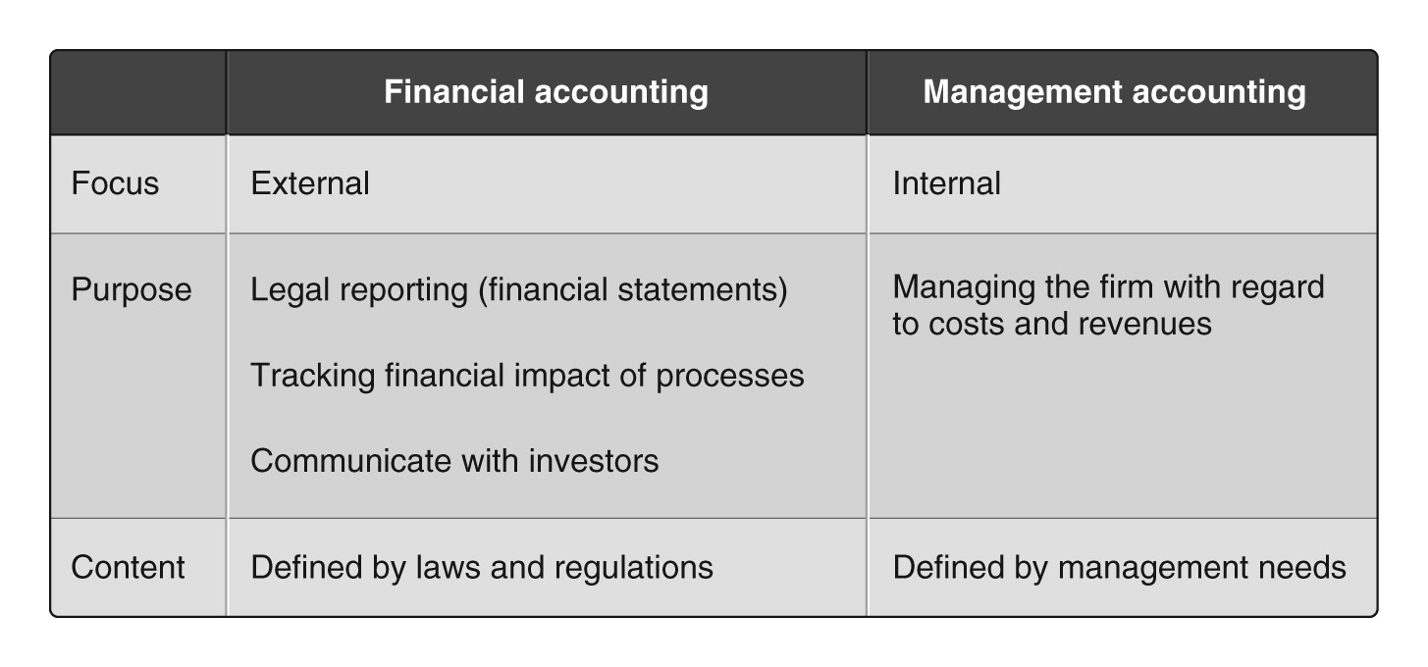
FI Accounting vs. CO Accounting

Slide 6
Key Financial Accounting Processes
General ledger accounting
Accounts receivable accounting
Accounts payable accounting
Asset accounting
Bank ledger accounting

Slide 7
Organizational Levels
Client
Company code
Business area

Slide 8
Client
Highest organizational level
Only one client per enterprise
Can have one or multiple company codes

Slide 9
Company Code
Highest organizational level for financial reporting (external, legal reporting)
Four-digit alphanumeric field
Smallest entity that supports a full set of books
General ledger, journals, etc.
At least one CC is required; can have more than one

Slide 10
Multiple Company Codes
One for each legal entity
One for each country
Buick
Cadillac
Oldsmobile
Chevrolet
Hummer
Saturn
Saab
GMC
GBI USA
GBI Germany
GBI Australia
Consolidate to the “parent” company code level

Slide 11
Business Areas
Internal division to generate financial statements
GM
Cars (Sedans)
Cars (Sports)
Pick-up
SUV
Minivan
Across Company Codes

Slide 12
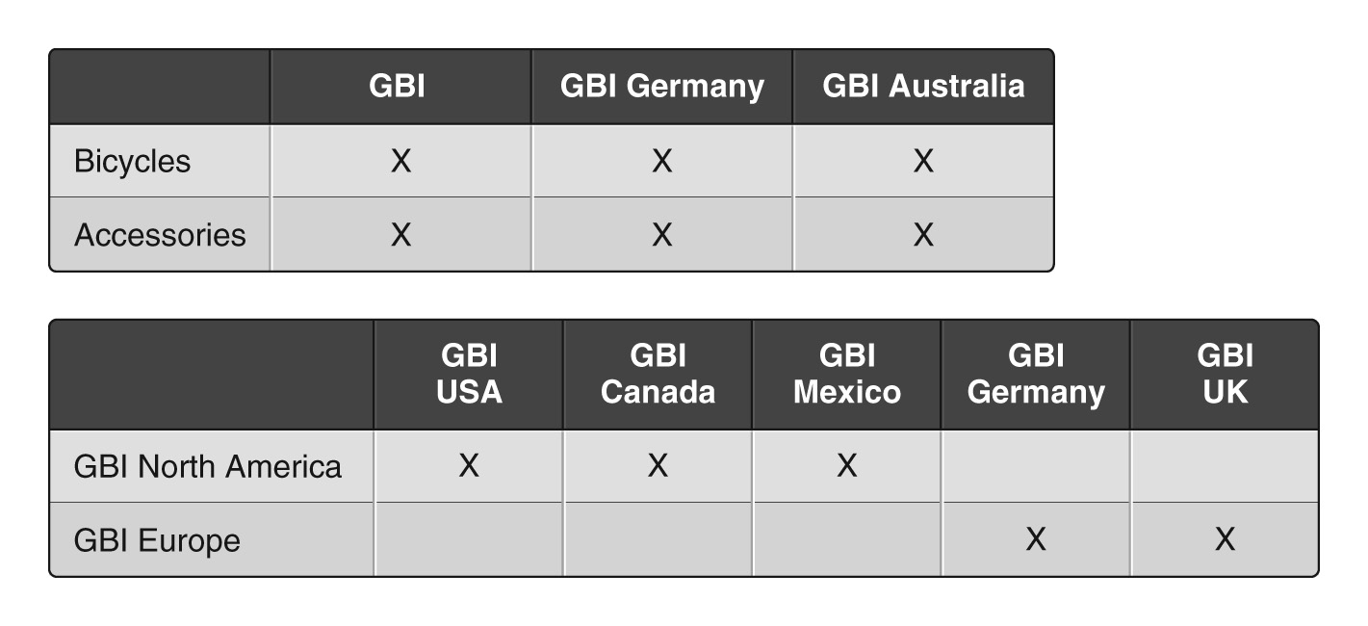
GBI Business Areas

Slide 13
Master Data
Chart of Accounts
General Ledger Accounts
Balance sheet accounts
Income statement accounts
Reconciliation accounts
Subsidiary ledgers (sub ledgers)
AR(customers)
AP (vendors)
Assets

Slide 14
Chart of Accounts
An orderly definition of accounts in the general ledger
Three types of chart of accounts:
Operative COA
Country-specific COA
Group COA
Multiple charts of accounts exist
US (CAUS) , Germany (GKR), Canada (CANA)
Country specific to meet reporting requirements
International Chart (INT)

Slide 15
Chart of Accounts
A chart of account can be used by multiple company codes
Different GM companies (Buick, Cadillac, Oldsmobile) can use the same (US) chart of accounts
Saab will use the German chart of accounts
A company must use at least one chart of account
Can use more than one chart of account to create alternate ledgers

Slide 16
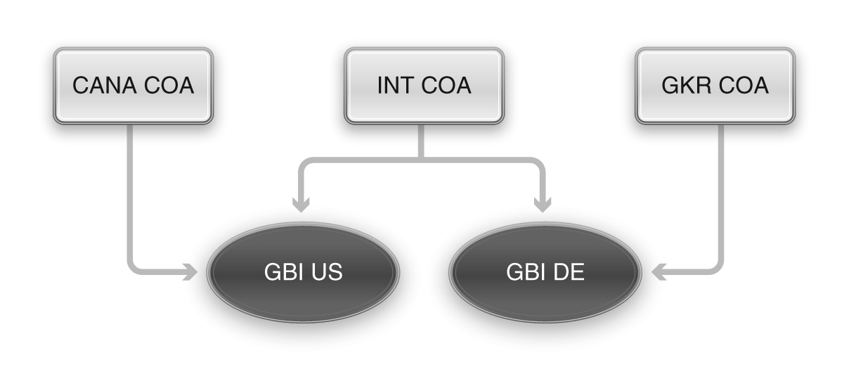
GBI Chart of Accounts and Company Codes

Slide 17
General Ledger Accounts
G/L accounts are master data
Recording of all accounting-relevant business transactions occurs in a G/L account
Data in the general ledger accounts are segmented by organizational level
Chart of account segment
Company code segment
General ledger = COA data + Company code data

Slide 18
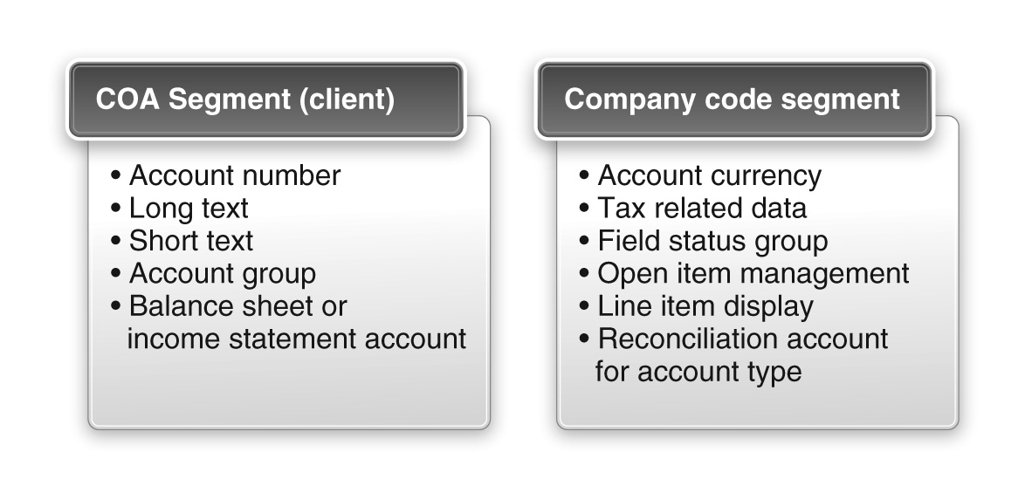
General Ledger Account Data

Slide 19
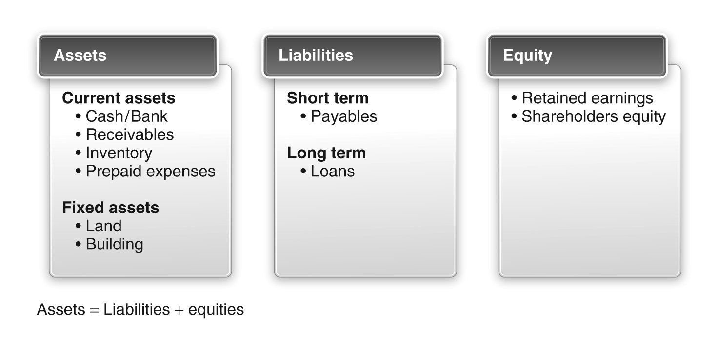
Balance Sheet Accounts

Slide 20
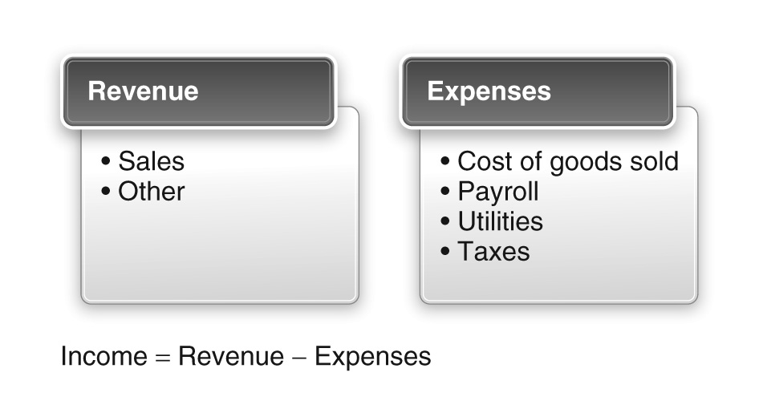
Profit and Loss Accounts

Slide 21
Demo 3-1: Review Charts of Accounts
Review the contents of the chart of accounts.

Slide 22
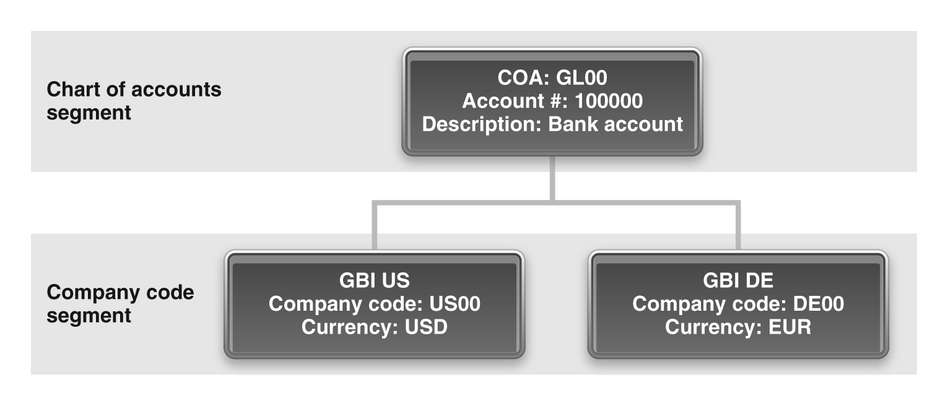
G/L Account Example

Slide 23
Sub-Ledger and Recon Accounts
Sub ledger account | Reconciliation account
Customer | Accounts Receivable
Vendor | Accounts Payable
Asset (specific) | Assets
Subsidiary or sub-ledgers
Reconciliation accounts
Are not part of the general ledger.
Used to separate accounting for customers, vendors, and assets
Are general ledger accounts
Consolidate data in sub-ledger
Cannot be posted to directly
Maintain the sum of the postings in corresponding sub-ledgers
Are specified in the definition of the sub-ledger

Slide 24
Demo 3-2: Review General Ledger Accounts
Review the contents of the general ledger.

Slide 25
Key Concepts
Key concepts to financial accounting are:
Accounting document
Parallel accounting
Concepts in Management Accounting

Slide 26
Document Type
Two-digit code that identifies the process that generated the document
Financial accounting document (FI)
Customer invoice (DR)
Customer payment(DZ)
Goods issue (WA)
Goods receipt (WE).
Determines the document number range and the account type that can be posted to

Slide 27
Account Type
Customer(D)
Vendor (K)
Asset (A)
Material (M)
General ledger accounts (S)

Slide 28
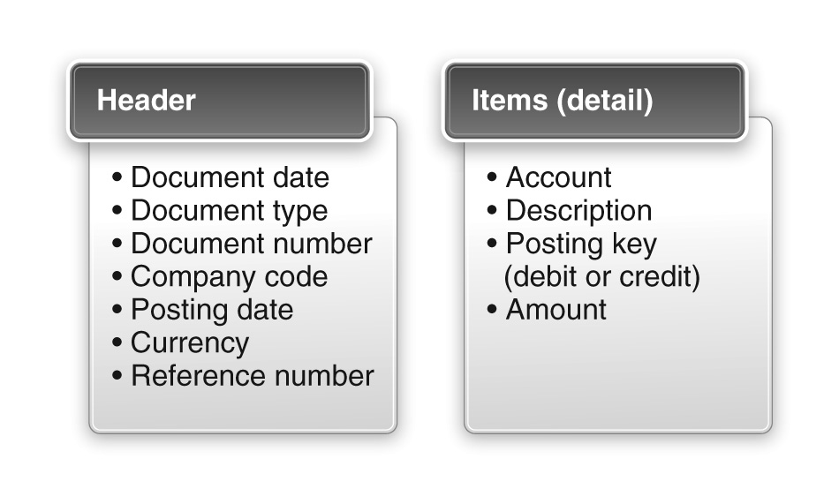
Structure of a FI Document

Slide 29
Posting Keys
A posting key is a two-digit code that determines how a line item is posted
The posting key specifies the following:
Account type for posting the document item
Whether the document item is posted as a debit or a credit
Field status of the additional data

Slide 30
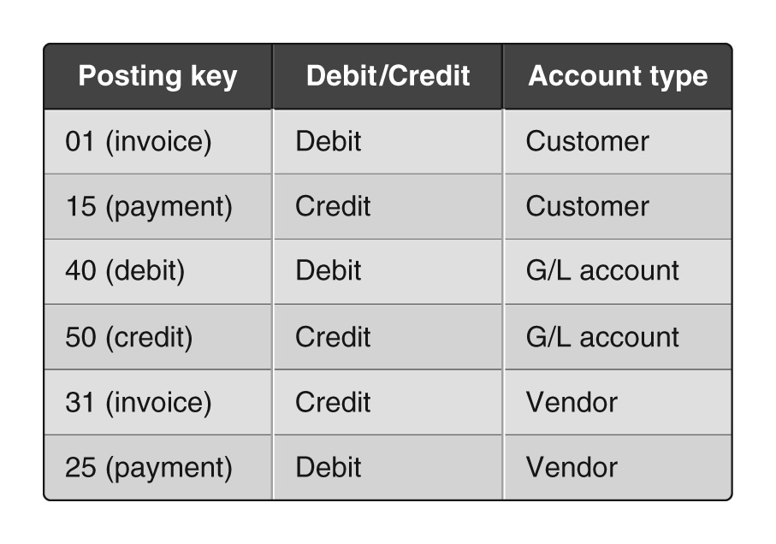
Posting Key Examples

Slide 31
Demo 3-3: Review an FI Document
Review the contents of an FI document.

Slide 32
Parallel Accounting
An enterprise can use multiple ledgers
Multiple “books” for different purposes
One leading ledger for all company codes
Global principles are consolidated
All transactions are posted to it
Non-leading ledgers for each company (company code)
Local accounting practices and reporting

Slide 33
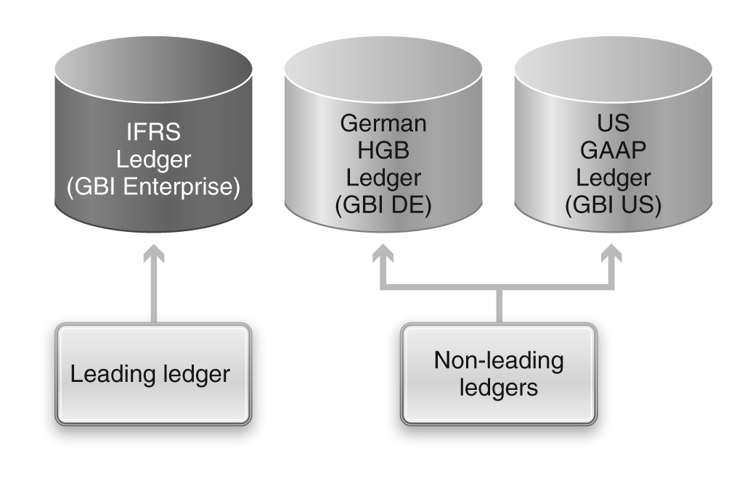
Parallel Accounting

Slide 34
Concepts in Management Accounting
Most of the data used in management accounting are derived from financial accounting
A key function of CO is to manage and allocate costs
Companies incur these costs as they carry out various business processes such as fulfillment

Slide 35
Cost Center
Master data in controlling
Location where costs are incurred
Department, individuals, special projects
Cost bucket used to accumulate costs
Accumulated costs are then “charged” to other cost centers – CO process
Many processes have “orders”
Purchase orders, Production orders, Sales orders
Expenses can be charged to these orders
Collectively objects that can absorb costs arecalled cost objects

Slide 36
Processes
Recording of value flows ($$) as a result of other processes and transactions
General Ledger Accounting
G/L postings for rent, utilities, wages, etc.
Accounts Payable Accounting
Part of the procurement process
Accounts Receivable Accounting
Part of the fulfillment process
Asset Accounting
Acquisition, depreciation, retirement

Slide 37
General Ledger Accounting
Concerned with recording the financial impact of all process steps performed within the organization
Double-entry accounting is used for every transaction
Accounts are divided into balance sheet accounts and income (profit and loss) statement accounts

Slide 38
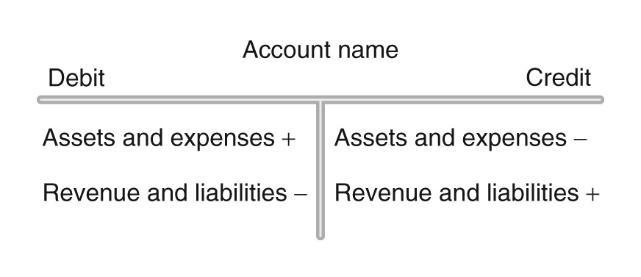
Debits and Credits

Slide 39
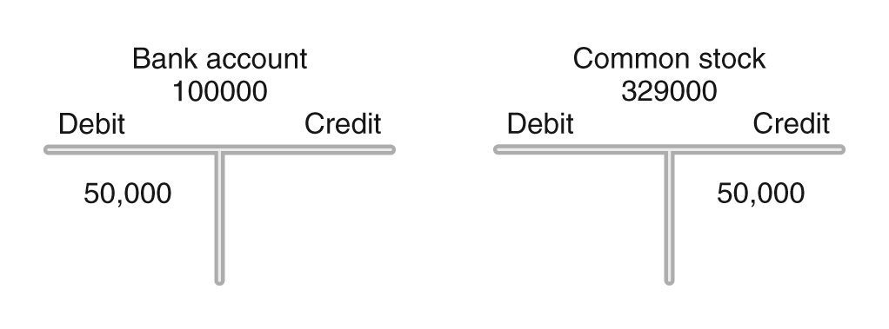
Posting Example 1: Investment in a Company

Slide 40
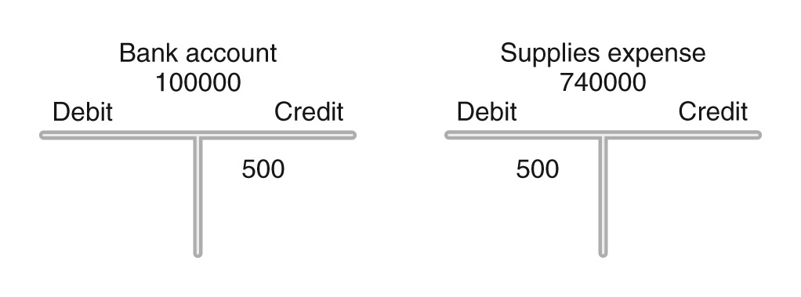
Posting Example 2: Purchase of Supplies With Cash

Slide 41
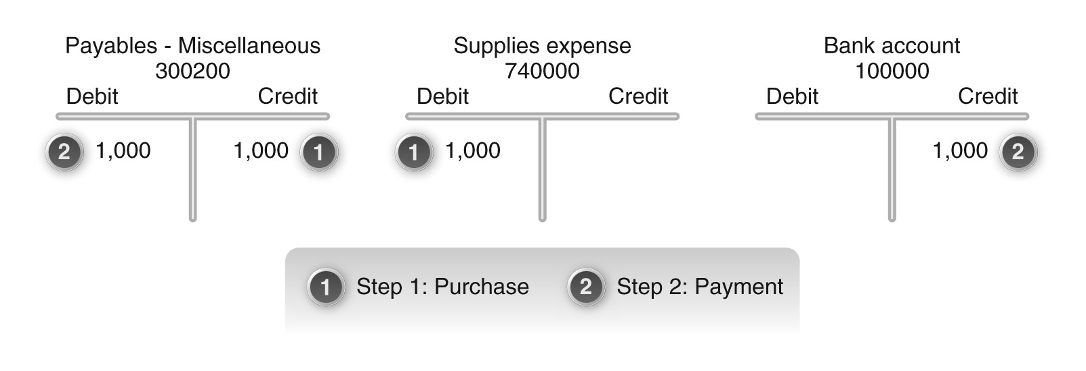
Posting Example 3: Purchase of Supplies On Credit

Slide 42
Demo 3-4: Post General Ledger Entries
Review the posting of general ledger entries.

Slide 43
Accounts Payable Accounting
Concerned with vendors
Involve sub-ledgers to track money owed to individual vendors: vendor master
Involve reconciliation accounts: Accounts payable-reconciliation
Recall the non-reconciliation AP account (payables-miscellaneous) discussed earlier
Involve GR/IR account (discussed in procurement chapter)

Slide 44
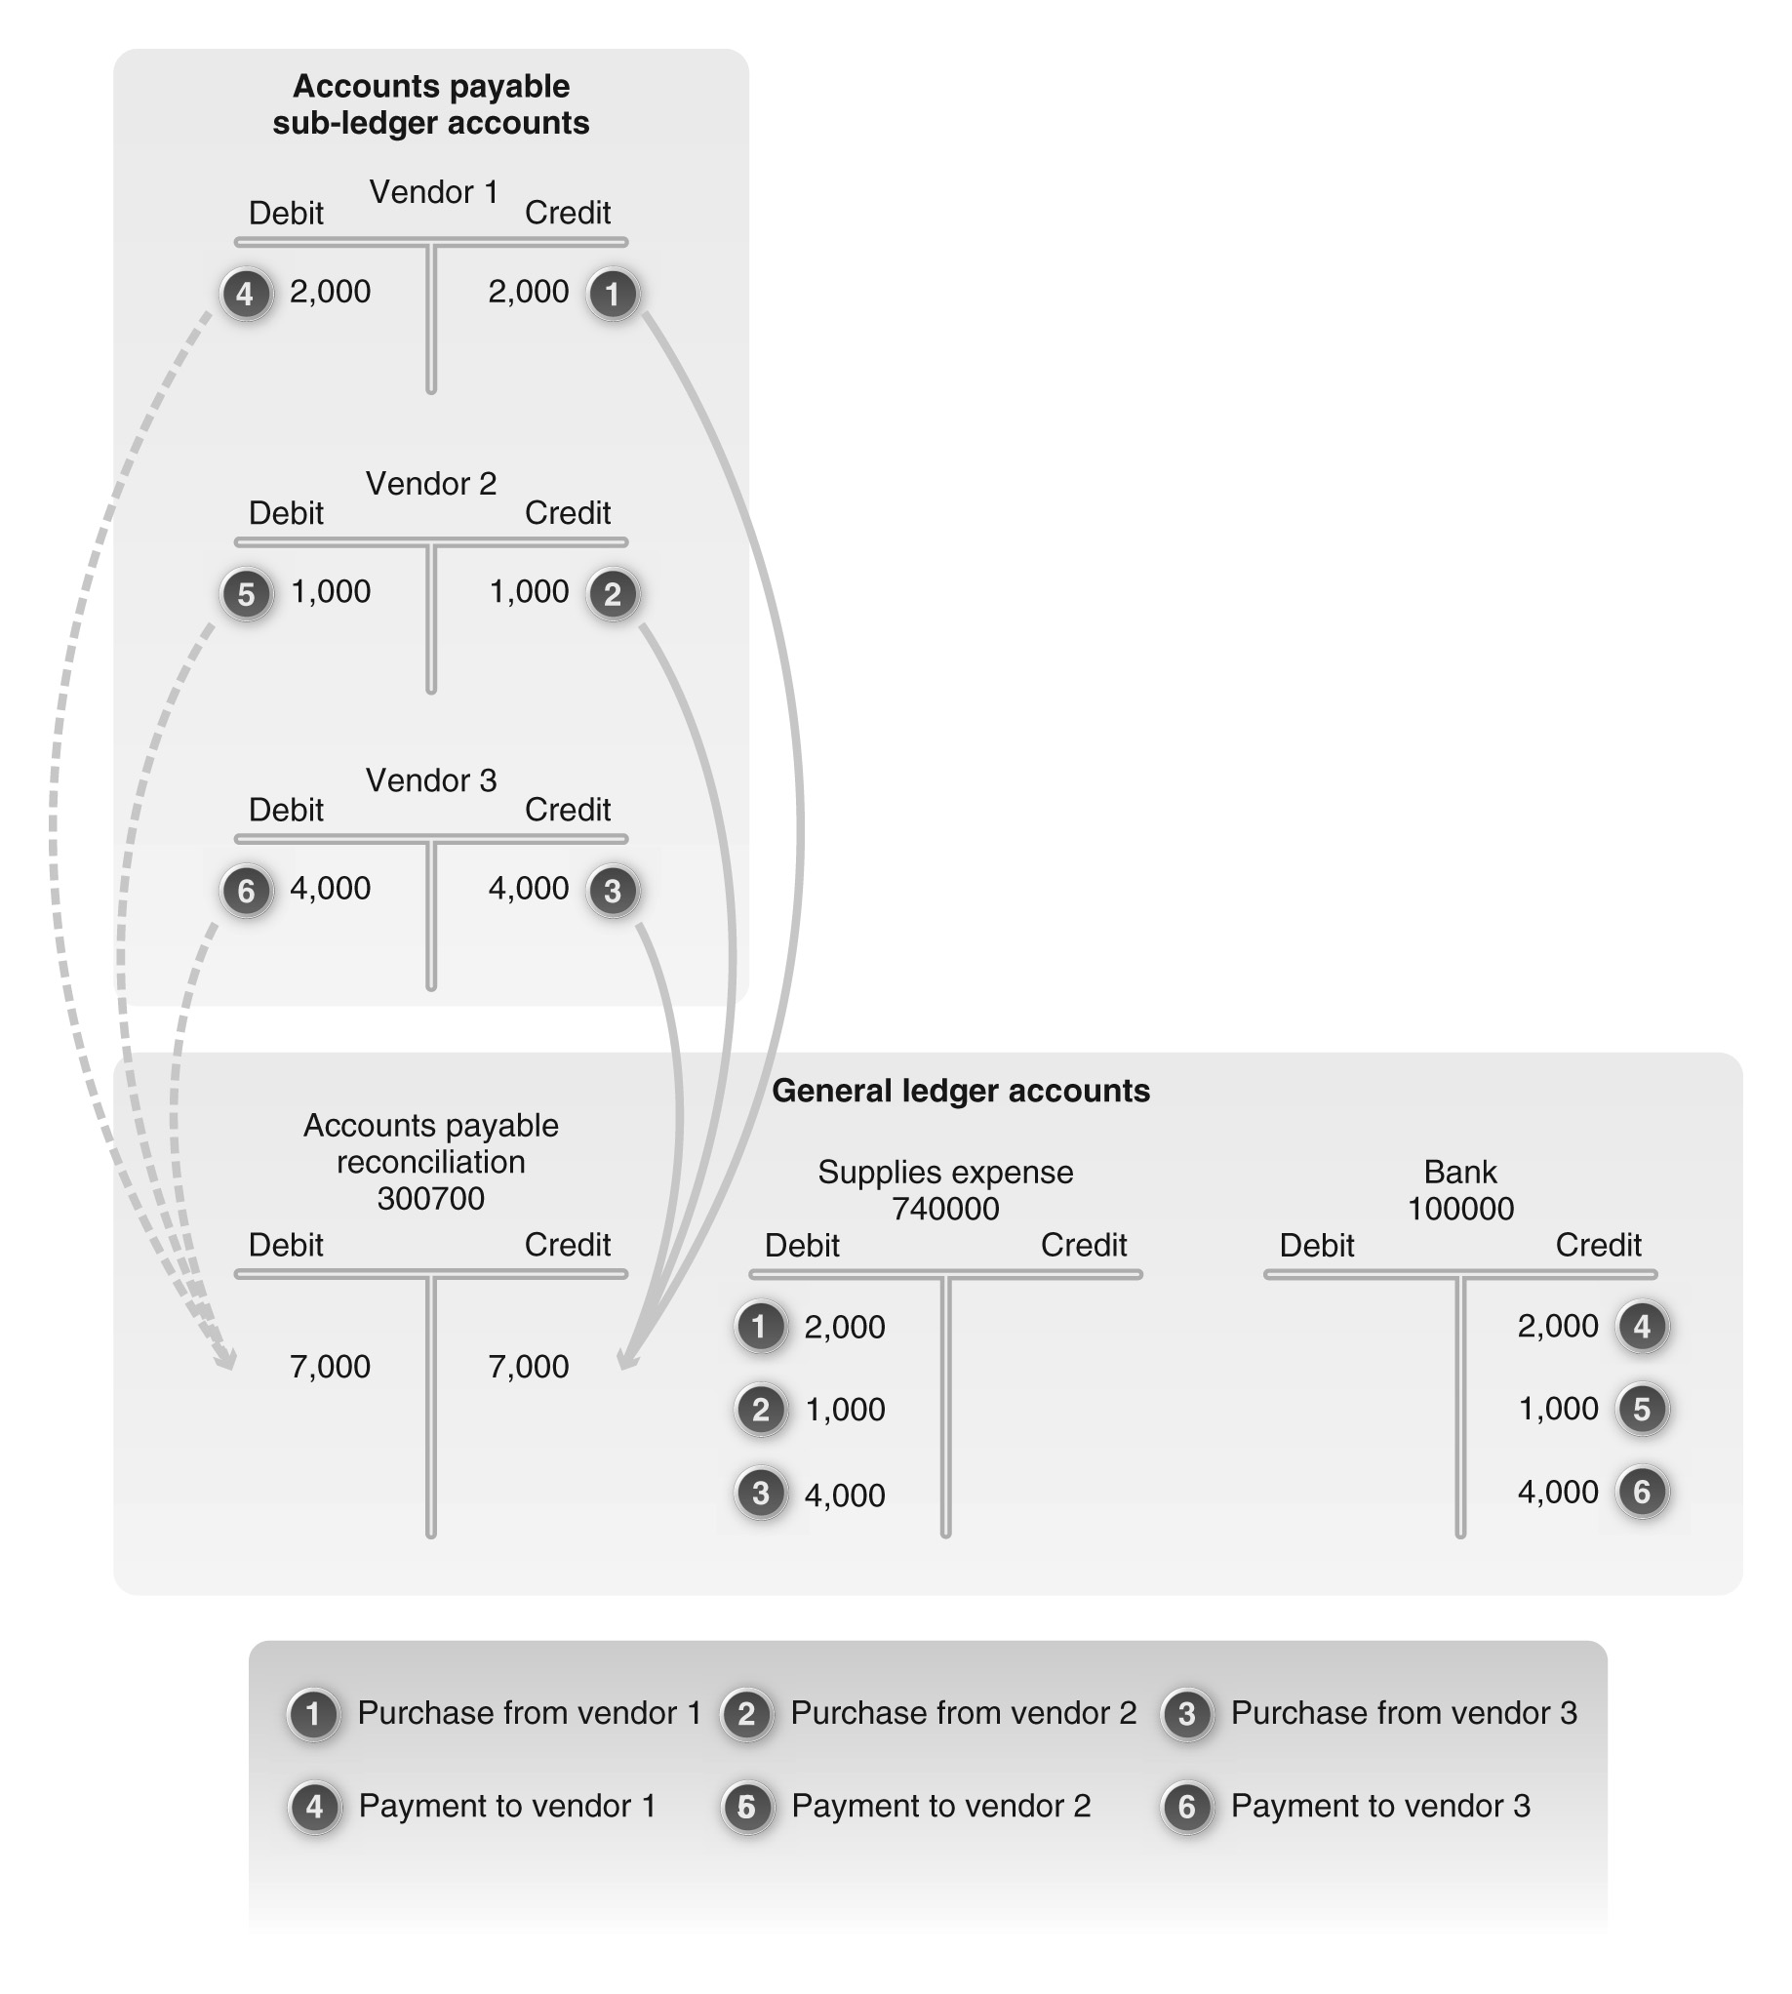
Accounts Payable Accounting

Slide 45
Demo 3-5: Review Reconciliation and Non-reconciliation A/P Accounts
Review the posting of reconciliation and non-reconciliation accounts payable accounts.

Slide 46
Accounts Receivable Accounting
Concerned with customers
Involves sub-ledger accounts: customer master
Involves reconciliations accounts: Accounts receivable – reconciliation
Non reconciliation AR accounts also exist (Misce AR)

Slide 47
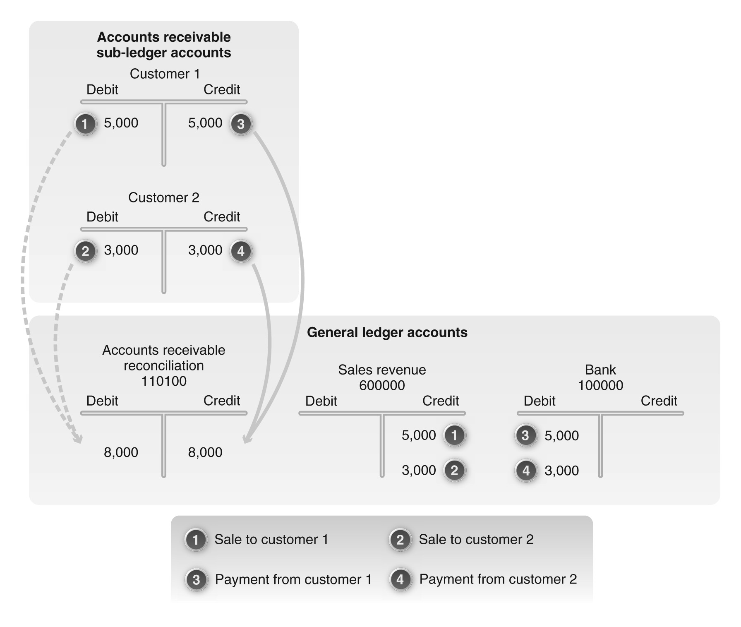
Accounts Receivable Accounting

Slide 48
Demo 3-6: Review Reconciliation and Non-reconciliation A/R Accounts
Review the posting of reconciliation and non-reconciliation accounts receivable accounts.

Slide 49
Asset Accounting
Concerned with tracking the financial consequences associated with the entire lifecycle of an asset, from acquisition to disposal (retirement).
Assets can be categorized as tangible, intangible, and financial
Tangible assets can be further categorized as:
Fixed assets
Leased assets
Assets under construction

Slide 50
Asset Accounting
Assets are assigned to
company code
Business area
Asset accounts
sub-ledgers accounts
General ledger
reconciliation accounts (in the general ledger)
Involves account determination (via asset classes)

Slide 51
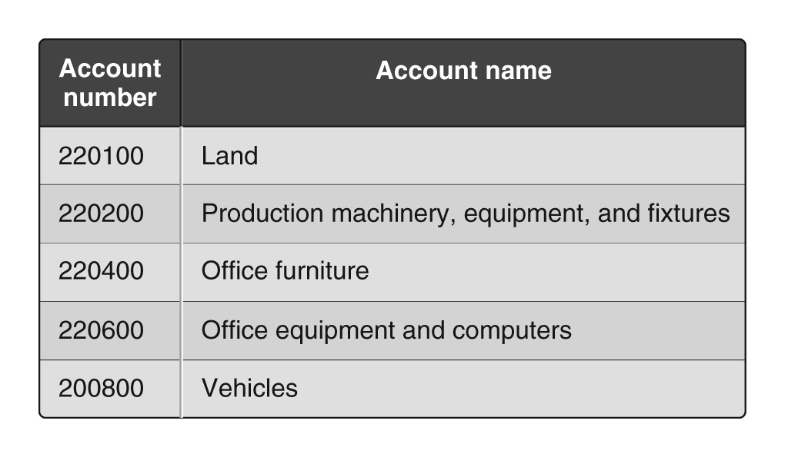
GBI Asset Accounts in the GL

Slide 52
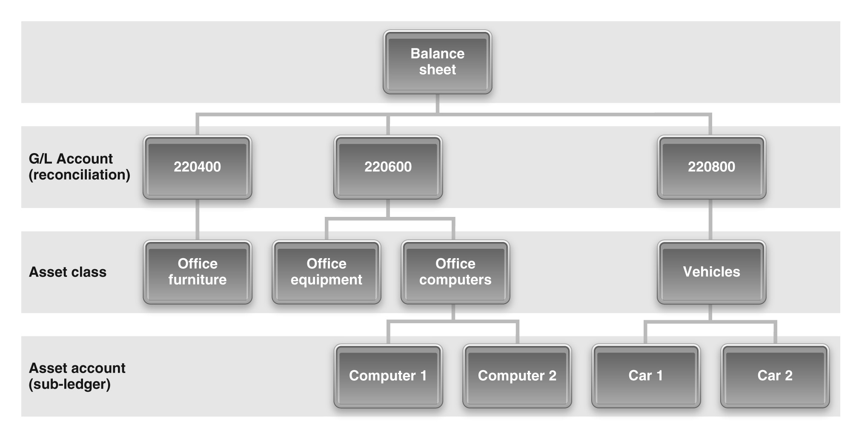
Asset Accounts and Account Determination

Slide 53
Demo 3-7: Review Asset Classes and Asset-Related Accounts
Review the uses of asset classes and asset-related accounts.

Slide 54
Asset Acquisition
Asset acquisition is concerned with acquiring assets via internal or external processes
Internal: production process or project systems
There are three options for purchasing assets externally:
Purchase from an established vendor without using the purchasing process (manual entry in GL and sub-ledger; similar to AP accounting)
Purchase from an established vendor using the purchasing process (different GL accounts)
Purchase from a one-time vendor or a vendor for whom master data are not maintained (via clearing account).

Slide 55
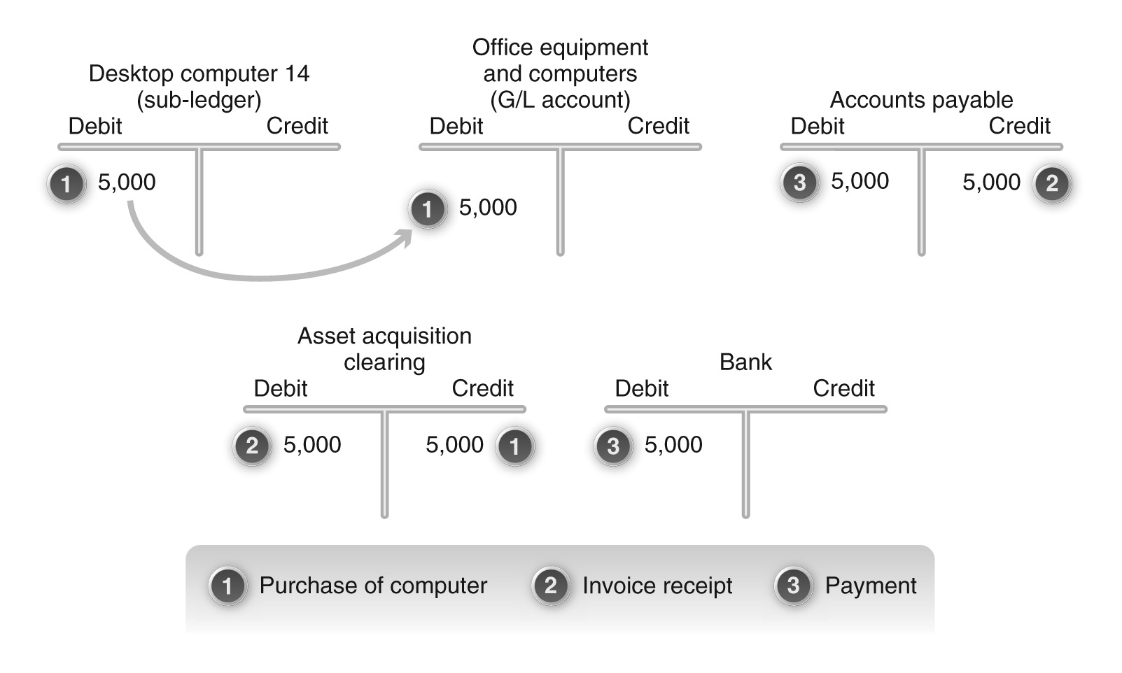
Asset Acquisition With a Clearing Account

Slide 56
Demo 3-8: Acquire an Asset
Review how an asset is acquired.

Slide 57
Asset Depreciation
Asset depreciaton is concerned with the decrease in the value of an asset over time
Depreciation can be planned or unplanned
Depreciation methods are used
Straight line
Double declining balance
Useful life
Residual value
Book value
Depreciation areas: parallel valuation

Slide 58
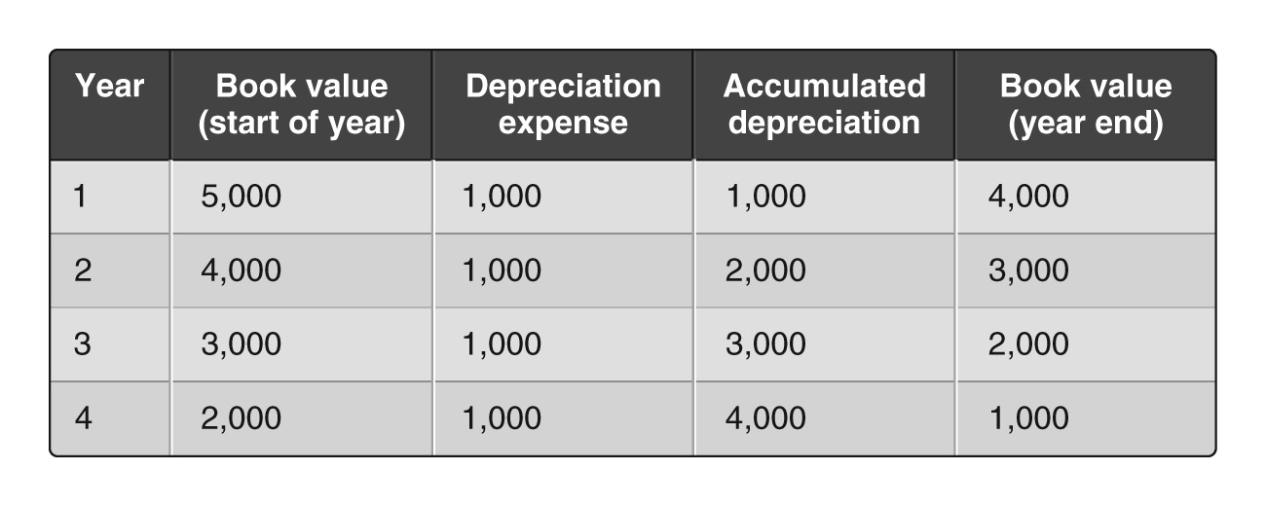
Straight Line Depreciation

Slide 59
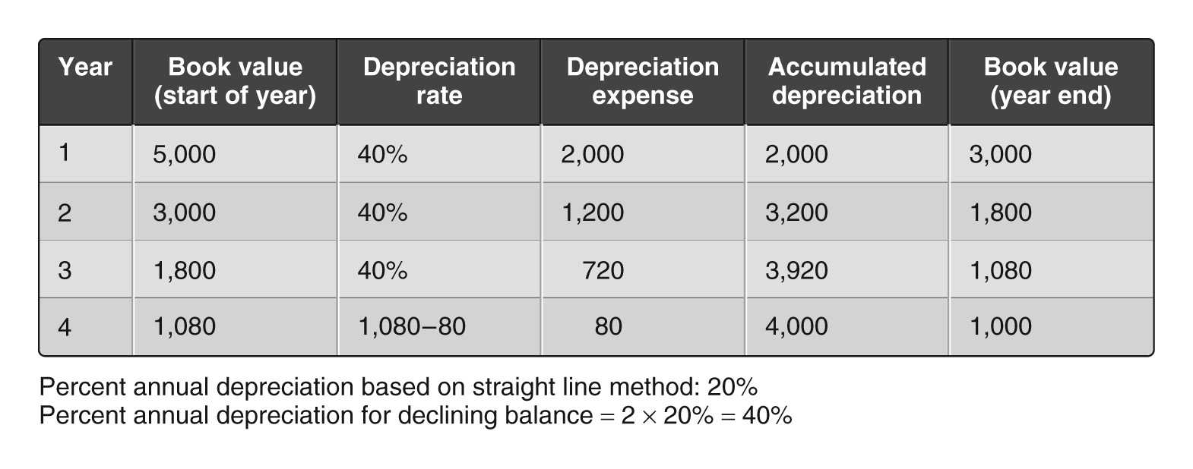
Double Declining Balance Depreciation

Slide 60
Asset Retirement
Concerned with the disposal or retirement of an asset after its useful life
Retirement may be:
Revenue generating (sold)
Non-revenue generating (scrapped)

Slide 61
Demo 3-9: Depreciate an Asset
Review how to depreciate an asset.

Slide 62
Integration of Financial Accounting with Other Processes
Financial accounting is integrated with other processes in SAP within the organization (enterprise)
Numerous steps in different processes have a financial impact

Slide 63
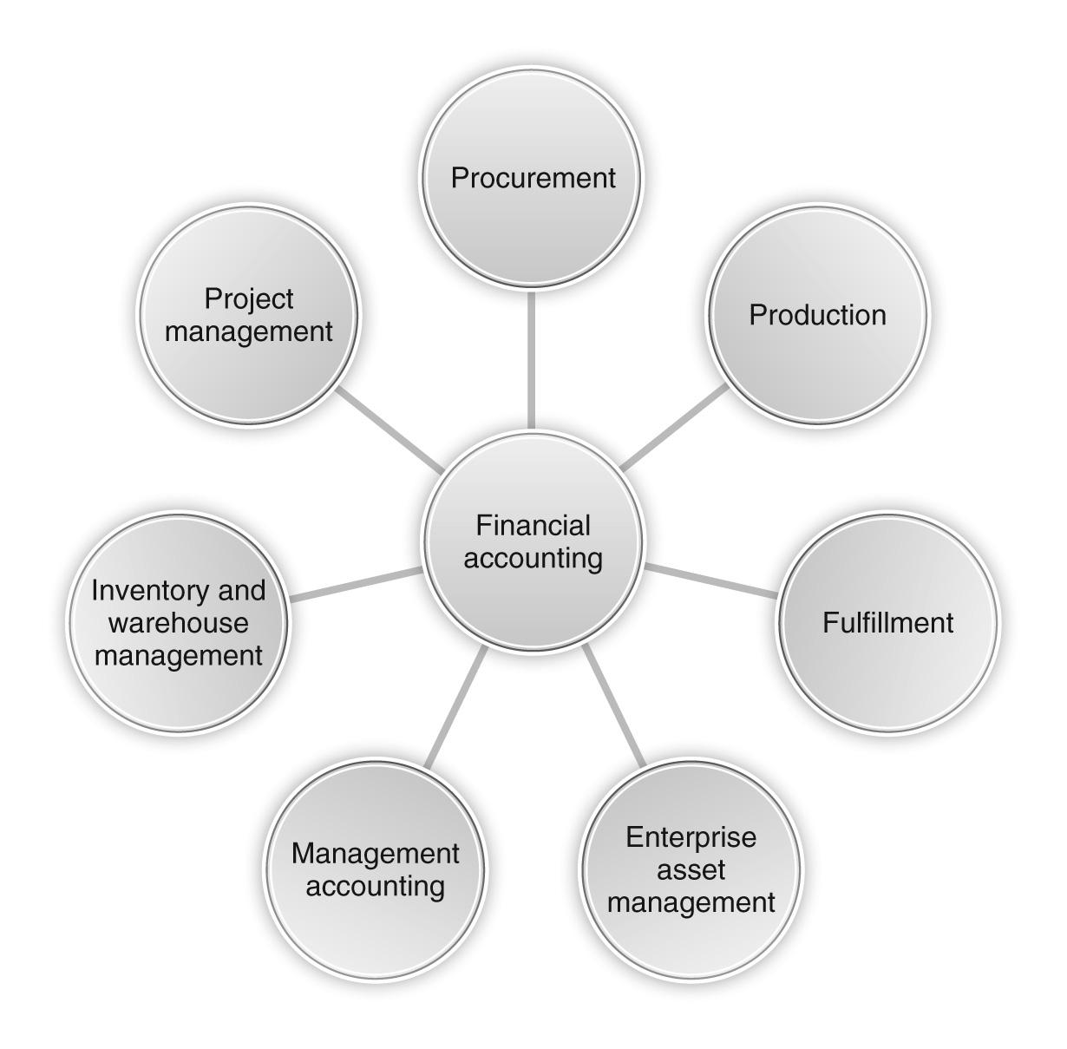
Integration of Financial Accounting with Other Processes

Slide 64
Reporting
Financial reporting is broadly divided into two categories:
Displaying account information
Generating financial statements

Slide 65
Account Information
Account information can be displayed at three levels:
Balance
Line item
Original FI document

Slide 66
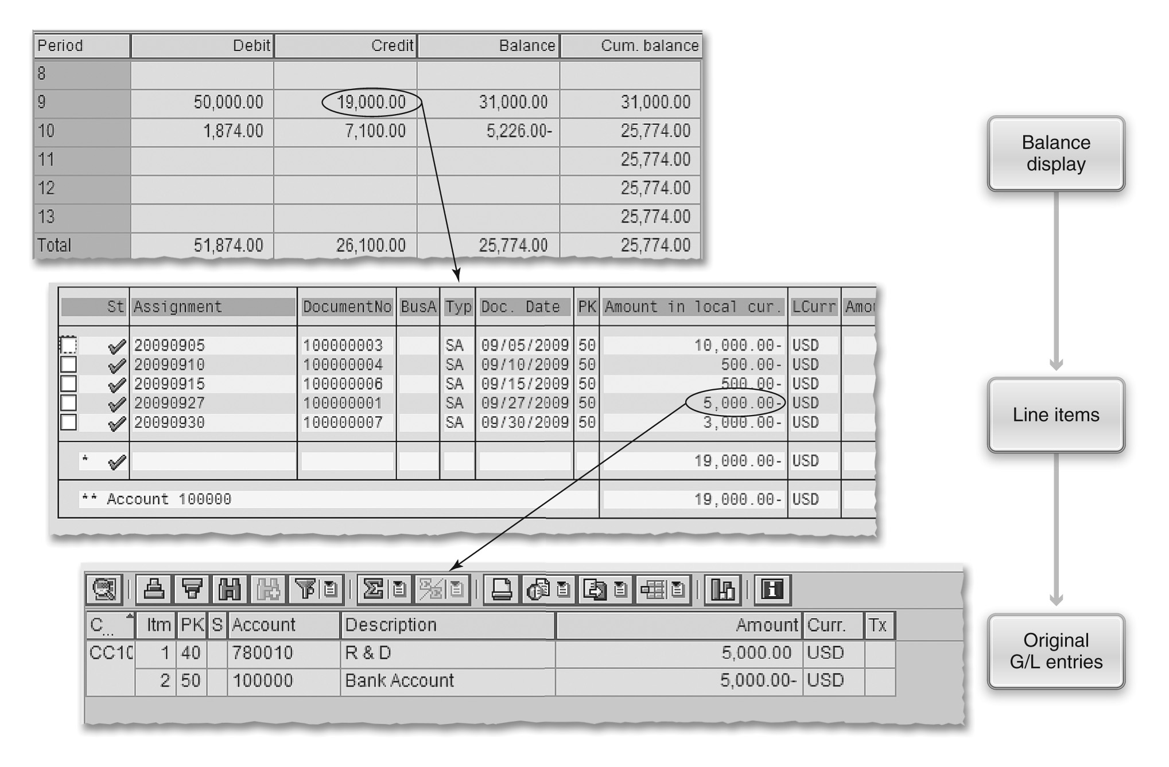
Account Information

Slide 67
Demo 3-10: Review Account Information
Review account information.

Slide 68
Asset Explorer
Asset explorer provides an overview of all activities related to the asset
Acquisition data
Planned and posted depreciation
Drill down details for:
Master data
Transactions
Documents
Depreciation posting run

Slide 69
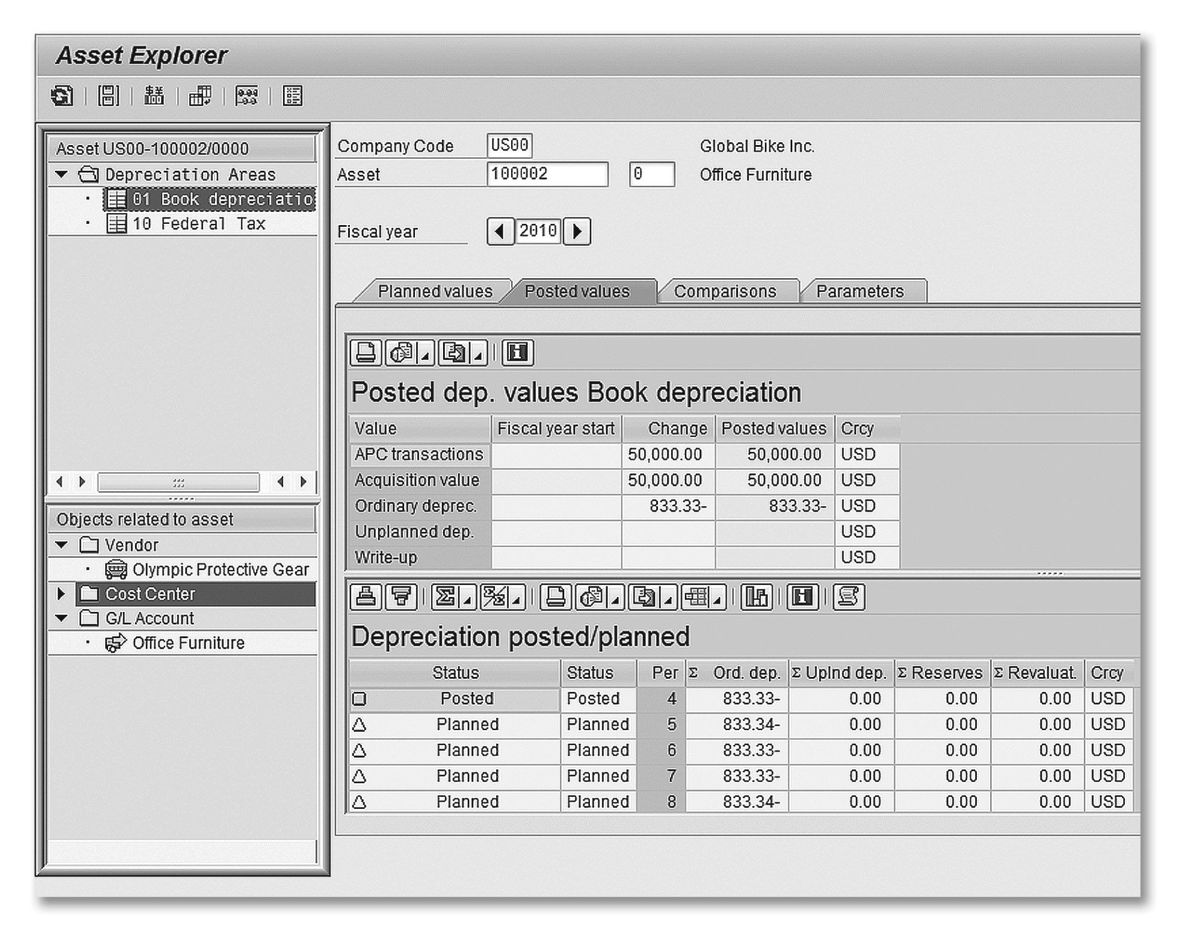
Asset Explorer

Slide 70
Demo 3-11 Review Asset Explorer
Review the capabilities of asset explorer.

Slide 71
Financial Statements
Three types
Balance Sheet
Income Statement
Statement of cash flows
Required for external reporting
Quarterly filings with the SEC?
Accuracy is critical – SOX compliance
Certified by CEO and CFO

Slide 72
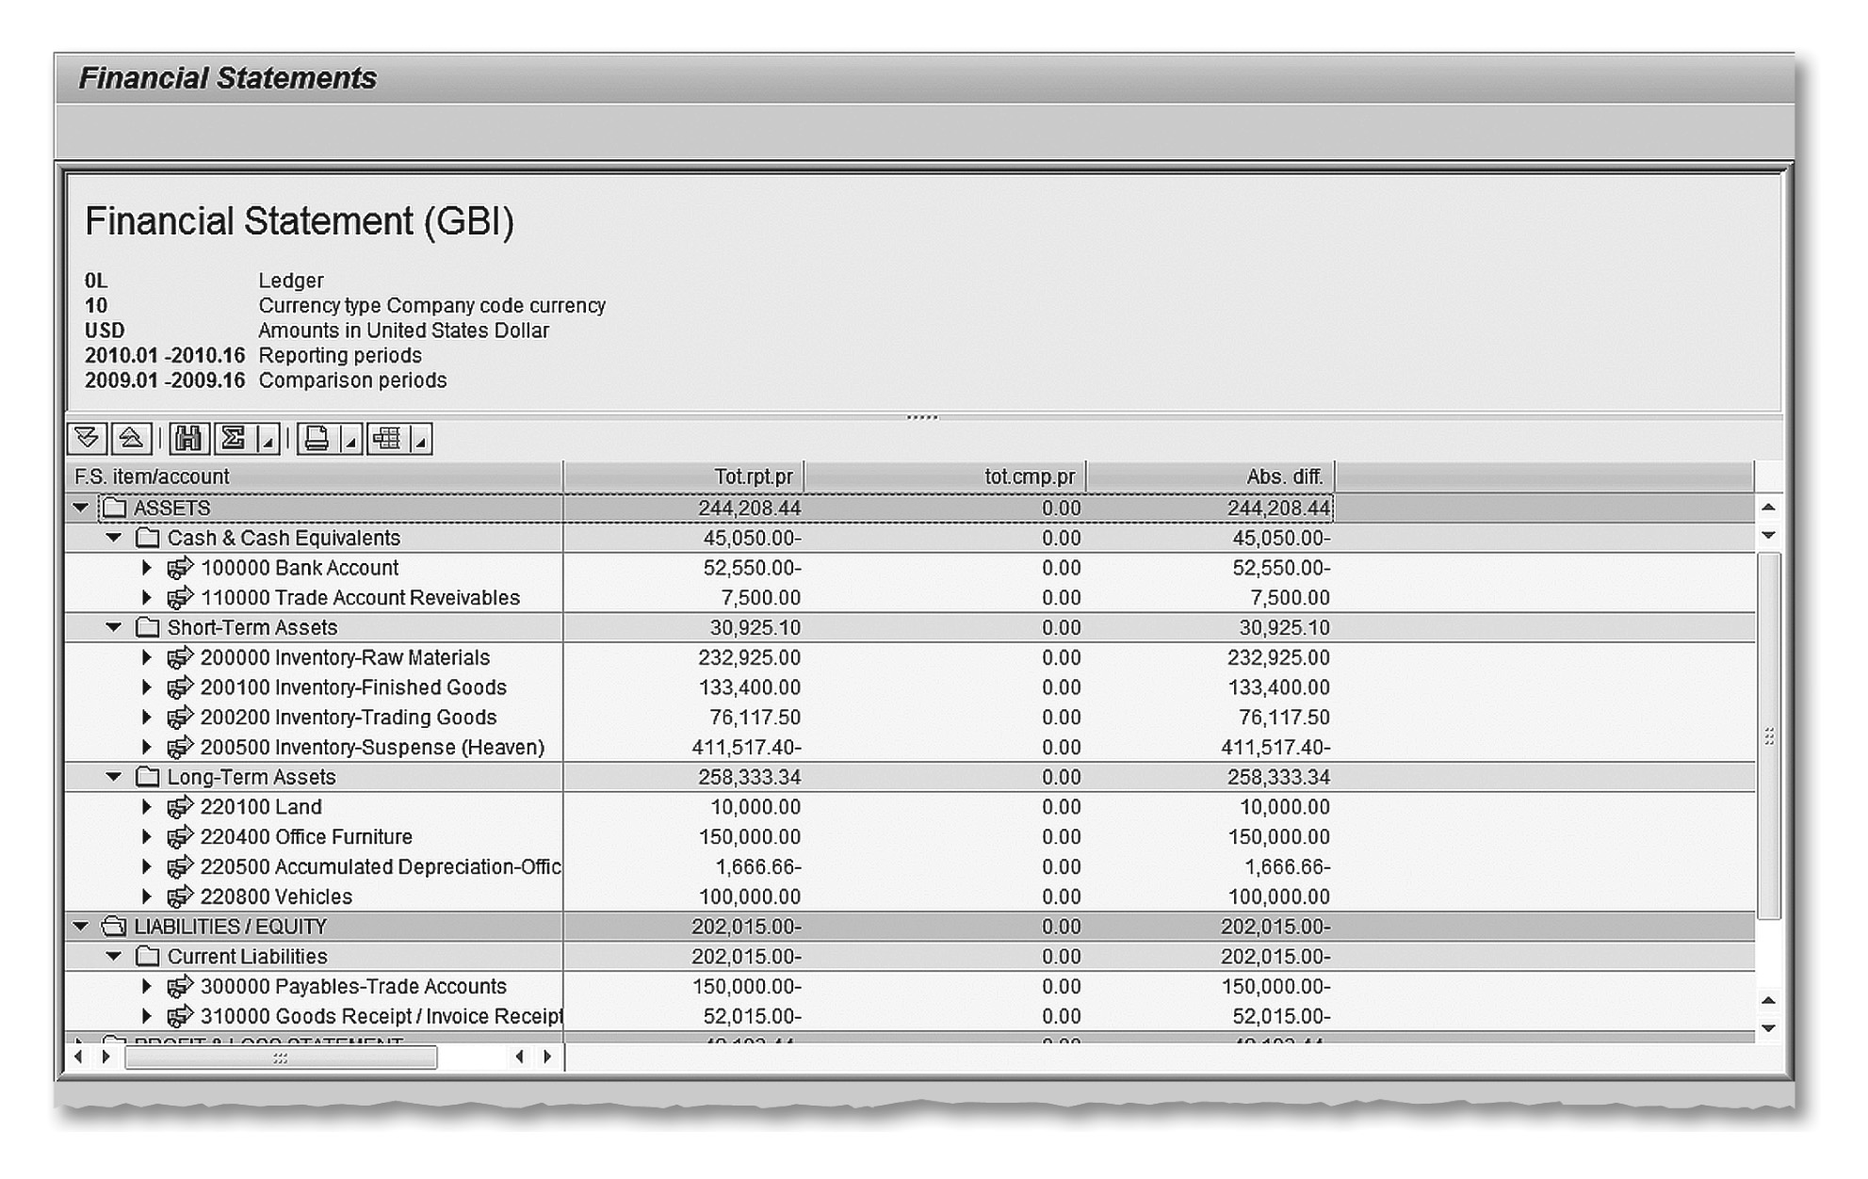
Financial Statement Version with Balance Sheet Accounts

Slide 73
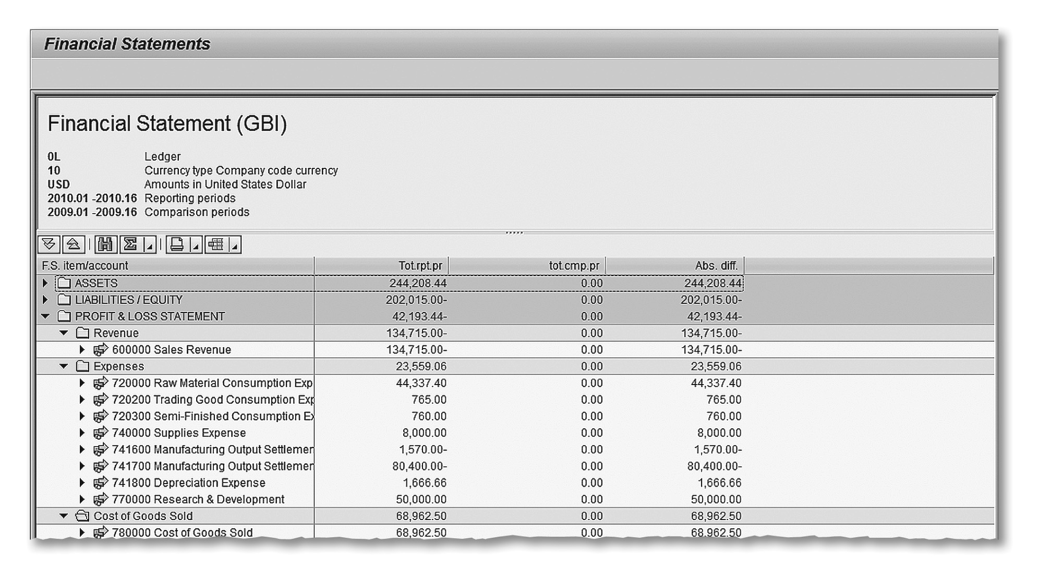
Financial Statement Version with Profit and Loss Accounts

Slide 74
Demo 3-12: Generate Financial Statements
Review the generation of financial statements.

Slide 75
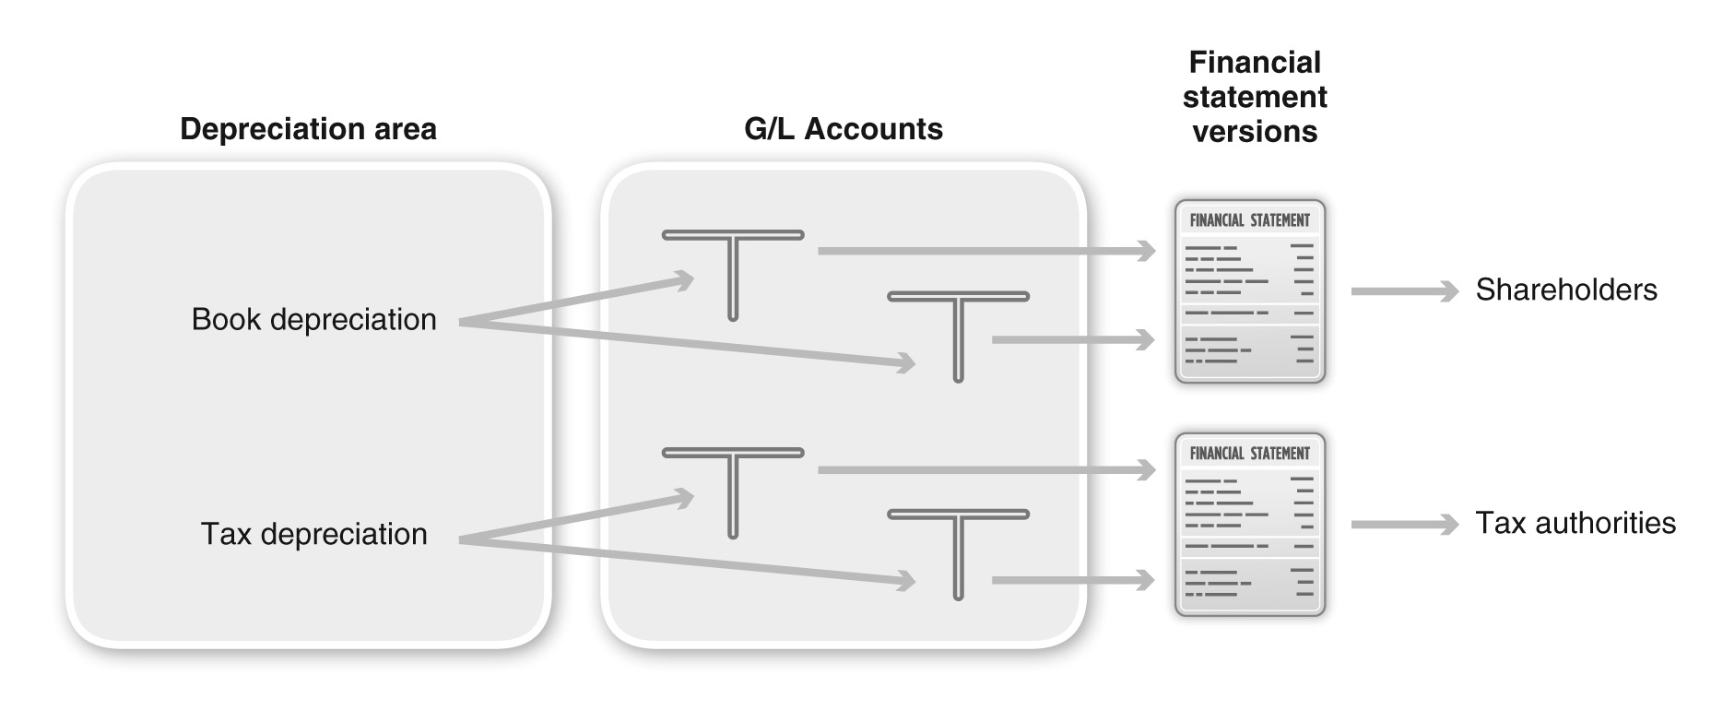
Financial Statements Based on Depreciation Areas

