Slide 1
CSFQ
Core-Stateless Fair Queueing
Presented
by
Nagaraj Shirali
Choong-Soo Lee
ACN: CSFQ
1

Slide 2
About the Authors
Ion Stoica – CMU
PhD degree from Carnegie Mellon University
Assistant Professor at University of California, Berkeley
Networking with an emphasis on Quality of Service and traffic management in the Internet
Hui Zhang – CMU
PhD degree from University of California, Berkeley
Associate Professor at Carnegie Mellon University
Internet, multimedia systems, resource management, and performance analysis
Scott Shenker – Xerox PARC
Chair for the Integrated Services (INTSERV) charter
ACN: CSFQ
2

Slide 3
Outline
Introduction
Background: Definitions and Previous Work
CSFQ and its Algorithms
Simulations
Evaluations of CSFQ
Conclusions and Future Work

Slide 4
Introduction
Main Idea:
- Achieve fair bandwidth allocations at the router without the implementation complexity usually associated with it.
Goals:
- Achieve fair allocation close to Fair Queueing and comparable or better than RED and FRED under most scenarios.
- Reduce complexity by not having the core node maintain per flow state.
- Approximate weighted FQ.

Slide 5
Outline
Introduction
Background: Definitions and Previous Work
CSFQ and its Algorithms
Simulations
Evaluations of CSFQ
Conclusions and Future Work

Slide 6
Previous Work
FIFO queueing with Drop Tail
Random Early Drop (RED)
Flow Random Early Drop (FRED)
Fair Queueing (FQ)

Slide 7
FIFO queueing with Drop Tail
FIFO
SERVER
Disadvantages:
Pushes congestion control out to end hosts (TCP)
Introduces global synchronization when packets are dropped from several connections

Slide 8
Random Early Drop (RED)
FIFO
SERVER
Maxth
Minth
Disadvantage:
For web traffic, RED provides no clear advantage over tail-drop FIFO for end-user response times
P(drop)
1.0
MaxP
Minth
Maxth

Slide 9
Flow Random Early Drop (FRED)
FIFO
SERVER
Disadvantage:
Complex to implement – maintain state on per-flow basis

Slide 10
Fair Queueing
Disadvantage:
Need to perform packet classification and maintain state and buffers on per-flow basis and perform operations on per-flow basis

Slide 11
Definitions
Island of routers – a contiguous portion of the network with well defined interior and edges.
Edge Router – computes per-flow rate estimates and labels the packets with these estimates.
Core Router – uses FIFO queueing and keeps no per-flow state, employs a probabilistic dropping algorithm that uses the packet label and its own measurement of aggregate traffic.
Stateless – absence of per-flow state at the core routers.

Slide 12
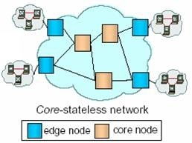
Island of Routers
Source: CSFQ, Stoica, Berkeley

Slide 13
Outline
Introduction
Background: Definitions and Previous Work
CSFQ and its Algorithms
Simulations
Evaluations of CSFQ
Conclusions and Future Work

Slide 14
CSFQ and its Algorithms
Assumptions:
Fair Allocation methods like FQ are necessary for congestion control.
The complexity involved is a major hindrance to their adoption.

Slide 15
CSFQ
In an island of routers, edge routers compute per-flow rate estimates and label the packets with these estimates.
Core routers use FIFO queueing and keep no per-flow state, they employ a probabilistic dropping algorithm based on packet labels and own aggregate traffic estimates.

Slide 16
CSFQ
Bandwidth allocations using this method are approximately fair.
Core routers keep no per-flow state and avoid using complicated packet scheduling and buffering algorithms, hence are easier to adopt.

Slide 17
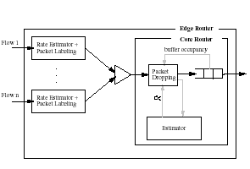
CSFQ
Assume that flow i has arrival rate r_{i}(t) and the fair rate is a(t).
If r_{i}(t) < a(t), all of its traffic is forwarded.
If r_{i}(t) > a(t), then a fraction (r_{i}(t) - a(t))/ r_{i}(t) will be dropped; each packet of the flow is dropped with probability (1-a(t)/r_{i}(t)). Thus the output rate of any flow i will be max(r_{i}(t) ,a(t)).

Slide 18
CSFQ
The problem now becomes how to calculate the flow rate r_{i}(t) values and the fair rate a(t), without keeping per flow state in the core routers.
Flow rates r_{i}(t), are calculated at edge routers which keep per flow state and then insert the rate value inside the packet header of packets belonging to that flow.

Slide 19
CSFQ
To estimate the fair rate a(t), an iterative procedure is used: core routers estimate aggregate arrival rate A and the aggregate rate of accepted traffic F (arrival rate – dropped packets).
Based on these, the fair rate a is computed periodically as:
- if there is no congestion (A<=C where C is the link’s capacity), then a is set to the maximum r_{i}(t)
- if the links are congested, then a_{new} = a_{old}*C/F

Slide 20
CSFQ - Example
Assume we have two flows f₁ and f_{2,} with rates r₁ = 20 and r₂ = 30
and the link’s capacity is C = 30. Initially let’s say that only r₁ is active
and the link is not congested, so a₁ = 20. Then r₂ becomes active.
Since no packets were dropped, F = 50.
Since A = 50>C, a₂ = a₁* C/F = 20 * 30/50 = 12
Therefore, for f₁ (1-12/20 = 40%) of its packets are dropped while for f₂
(1-12/30 = 60%) of its packets are dropped and F = 12+12 = 24
Since A>C, a₃ = a₂* C/F = 12 * 30/24 = 15
Now F = 30, and a₄ = a₃* C/F = 15 * 30/30 = 15. Therefore, a has
converged to the right fair rate.
Source: Network Reading Group, Stoica

Slide 21
CSFQ
Estimation of flow arrival rates:
R_{new} = (1-e^{-T/K})*l/T + e^{-T/K}*R_{old}
where T = packet interarrival time
l = packet size
K = constant
To summarize, Edge routers needs to
Classify the packet to a flow
Update the fair share rate estimation for the outgoing link
Update the flow rate estimation
Label the packet

Slide 22
Outline
Introduction
Background: Definitions and Previous Work
CSFQ and its Algorithms
Simulations
Evaluations of CSFQ
Conclusions and Future Work

Slide 23
Simulations – Single Congested Link
0
1
10Mbps
UDP
Flows
2
.
.
.
31

Slide 24
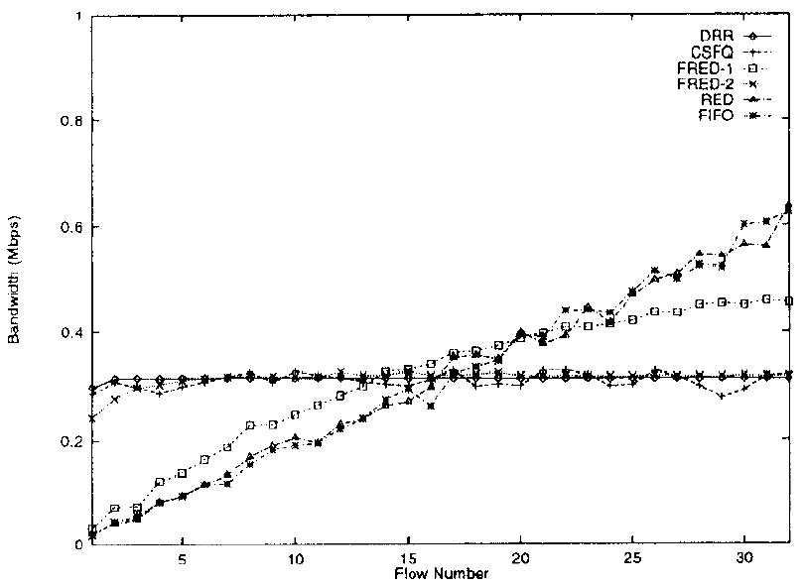
Simulations – Single Congested Link

Slide 25
Simulations – Single Congested Link
UDP
Flow
0
1
10Mbps
2
TCP
Flows
.
.
.
UDP flows at 10Mbps
31
10Mbps

Slide 26
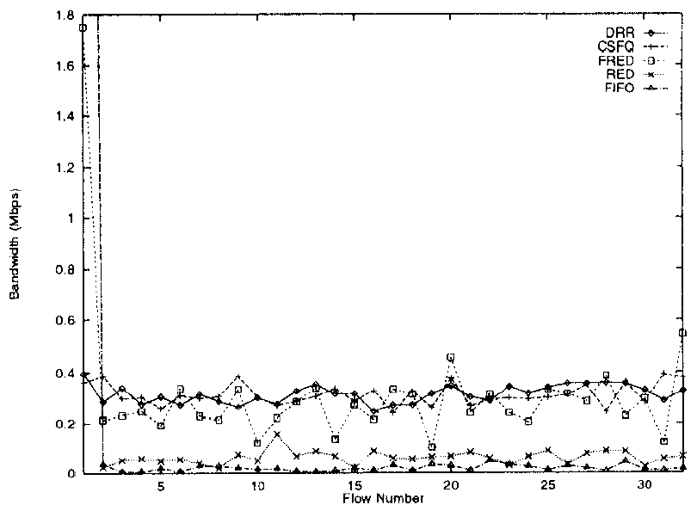
Simulations – Single Congested Link

Slide 27
Simulations – Single Congested Link
TCP
Flow
0
1
10Mbps
2
UDP
Flows
.
.
.
N

Slide 28
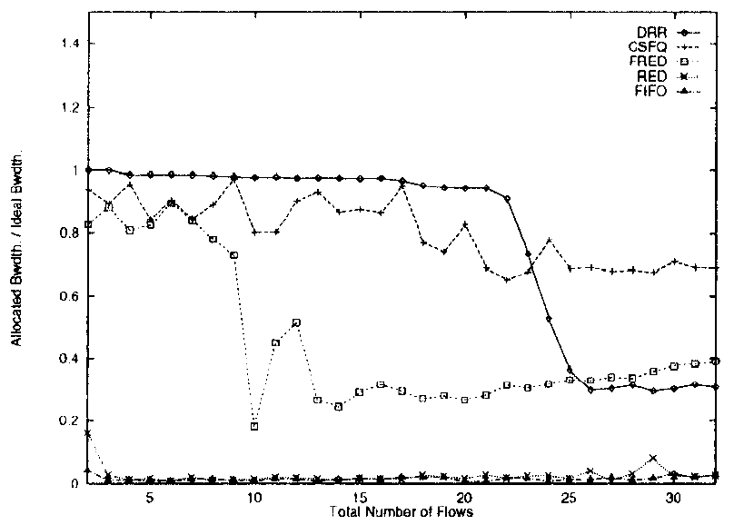
Simulations – Single Congested Link

Slide 29
Simulations – Multiple Congested Links
UDP1
UDP10
Sinks
TCP/UDP
Source
TCP/UDP
Sink
10Mbps
Links
Sources
UDP1
UDP10

Slide 30
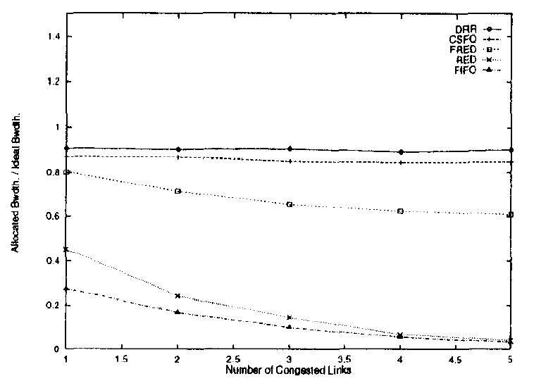
Simulations – Multiple Congested Links
UDP

Slide 31
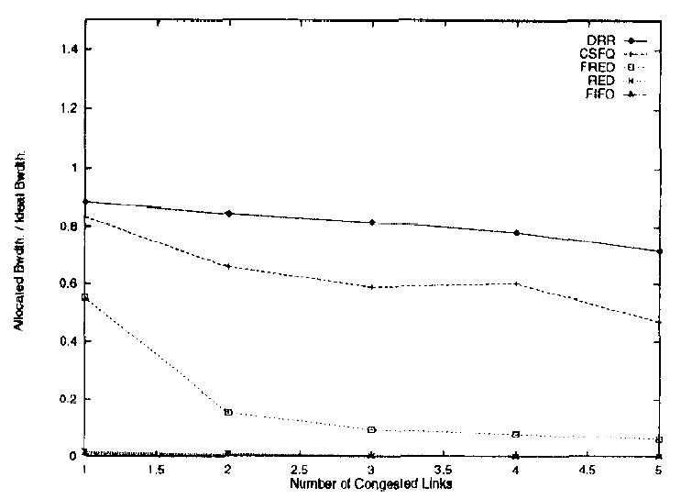
Simulations – Multiple Congested Links
TCP

Slide 32
Simulations – Coexistence of
Adaptation Schemes
RLM (Receiver-driven Layered Multicast)
Only first 5 layers (~0.992Mbps)
TCP-friendly like
3 RLM flows and 1 TCP flow

Slide 33
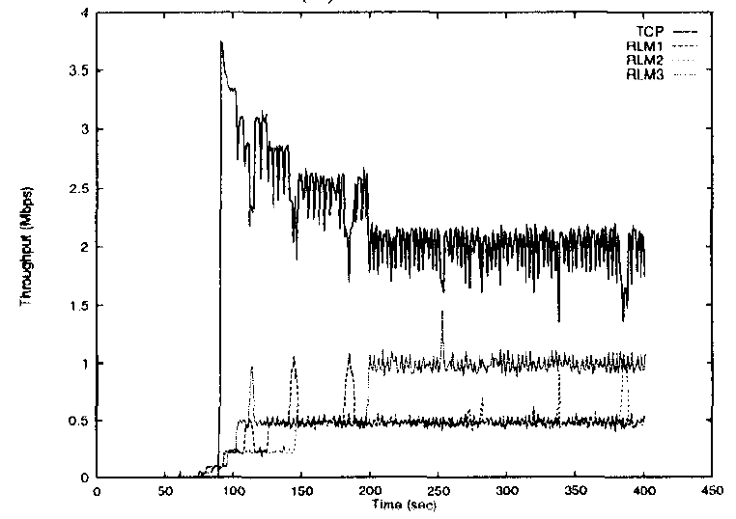
Simulations – Coexistence of
Adaptation Schemes
FIFO

Slide 34
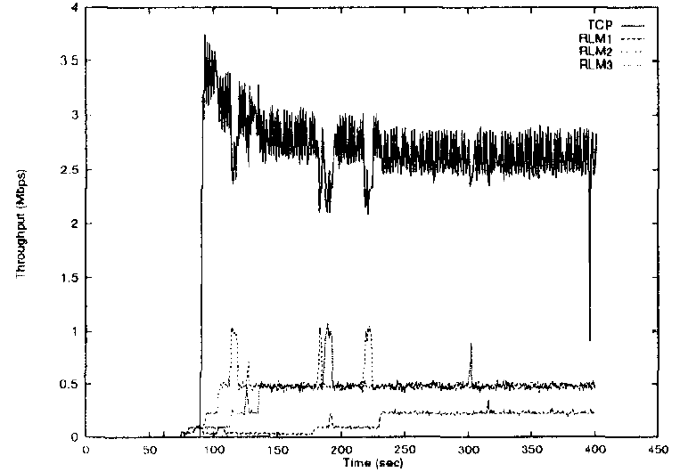
Simulations – Coexistence of
Adaptation Schemes
RED

Slide 35
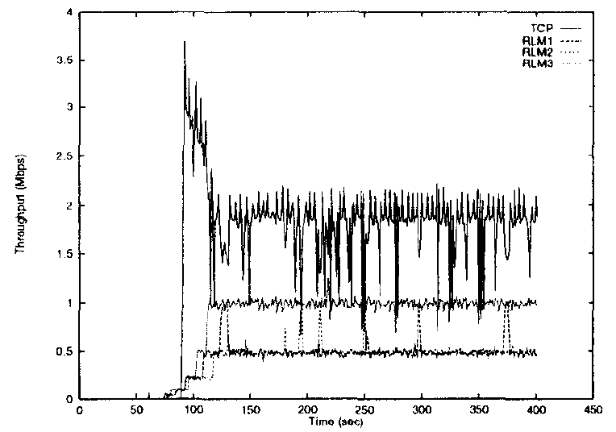
Simulations – Coexistence of
Adaptation Schemes
FRED

Slide 36
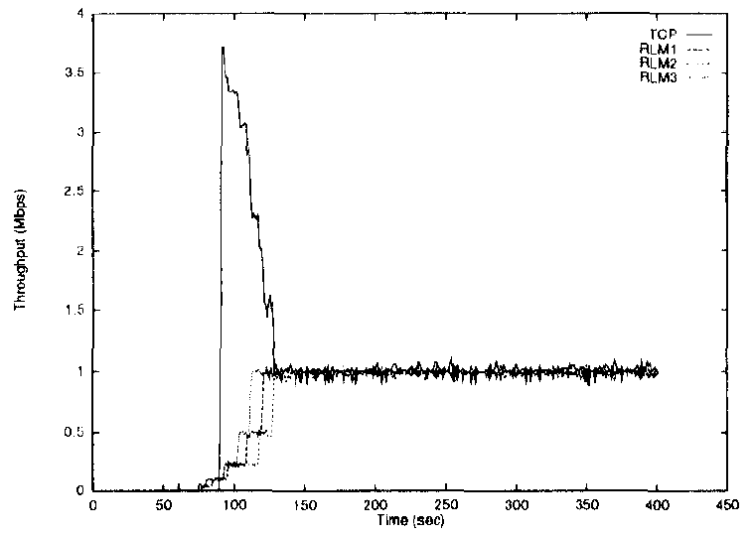
Simulations – Coexistence of
Adaptation Schemes
DRR

Slide 37
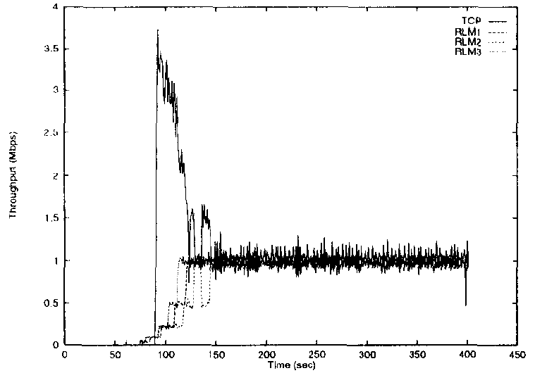
Simulations – Coexistence of
Adaptation Schemes
CSFQ

Slide 38
Simulations – Different Traffic Models
1 On/Off Flows
100ms on, 1900ms off
Rate : 10Mbps
Sends 6758 packets
19 competing TCP flows

Slide 39
Simulations – Different Traffic Models
Algorithm | Delivered | Dropped
DRR | 601 | 6157
CSFQ | 1680 | 5078
FRED | 1714 | 5044
RED | 5322 | 1436
FIFO | 5452 | 1306

Slide 40
Simulations – Different Traffic Models
60 TCP Flows
Exponentially distributed inter-arrival times with mean of 0.05ms
Pareto distributed transfer time with mean of 20 packets
1 UDP flow (10Mbps)

Slide 41
Simulations – Different Traffic Models
Algorithm | Mean time | Std. dev
DRR | 25 | 99
CSFQ | 62 | 142
FRED | 40 | 174
RED | 592 | 1274
FIFO | 840 | 1695

Slide 42
Simulations – Large Latency
10Mbps link with 100ms latency
1 UDP flow at 10Mbps
19 TCP flows
Algorithm | Mean | Std. dev
DRR | 6080 | 64
CSFQ | 5761 | 220
FRED | 4974 | 190
RED | 628 | 80
FIFO | 378 | 69

Slide 43
Simulations – Packet Relabeling
Sources
Sink
10Mbps
links

Slide 44
Simulations – Packet Relabeling
Traffic | Flow 1 | Flow 2 | Flow 3
UDP | 3.36 | 3.32 | 3.28
TCP | 3.43 | 3.13 | 3.43

Slide 45
Outline
Introduction
Background: Definitions and Previous Work
CSFQ and its Algorithms
Simulations
Evaluations of CSFQ
Conclusions and Future Work

Slide 46
Evaluations of CSFQ
Reasonable approximation of fair share
Roughly comparable performance to FRED
Sometimes much better than FRED
Note : FRED has per-packet overhead
Not quite as fair as DRR

Slide 47
Outline
Introduction
Background: Definitions and Previous Work
CSFQ and its Algorithms
Simulations
Evaluations of CSFQ
Conclusions and Future Work

Slide 48
Conclusions and Future Work
CSFQ
rate-based active queue management
Rate estimation at the edge and packet labels for core routers
Large latency effect
Possible extension of CSFQ for QoS

Slide 49
Back-up Slide(s)
Slide 2
Ion Stoica – research interest is to develop techniques and architectures that allow powerful and flexible network services to be deployed in the Internet without compromising its scalability and robustness.
Scott Shenker - The working group will focus on defining a minimal set of global requirements which transition the Internet into a robust integrated-service communications infrastructure.
Slide 4
- Congestion today (1998) is controlled by end-hosts (TCP)
FQ – has to maintain state, manage buffers, perform packet scheduling on per-flow basis.
Slide 8
SFloyd, Jacobson, 93. For long-lived TCP connections like file transfer, it might make a difference.
Slide 9
Dong Lin, Robert Morris in 1997 – works well with different traffic – TCP and UDP etc.
Slide 10
DDR – Deficit Round Robin or WFQ.
Slide 21
Exponential average to estimate the rate of flow since this closely reflects a fluid averaging process which is independent of the packetizing structure. And the solution is bounded as it converges to a real value.

