Slide 1
Wireless Andrew Building a high speed Campus-wide wireless data network By Bernard J Bennigton & Charles R Bartel Review by Preeti Kothari 12th March 2002

Slide 2
Wireless Andrew- Project Overview Deployment Issues & Challenges

Slide 3
Outline
Introduction: Wireless Andrew - 1994
Background and Objectives
Review of Wireless Technologies
Spread Spectrum Techniques
Review 802.11
Deployment Issues & Challenges
Interference
Throughput
Coverage
Phase I Installation - 1995-97
Phase II - 1998

Slide 4
Carnegie Vision -- 1994
Establish Common Research Network
NSF Grant - $550,000 over 2 years
Objective: Build an Experimental, high-speed wireless network installed at Carnegie Mellon University
Integrated with “wireline” Andrew
Support research projects in wireless communication and mobile computing
Wireless access to campus network
Handheld Andrew: follow-on project, enhancing usability of palm and HPCs with access to campus network
Researcher’s “Field of Dreams”-projects involving location-based information, rapid response surveys,…
email,access to stored audio and imaging data, file transfers, access to the library and other databases, and full Internet Services

Slide 5
Wireless Vs Wire
State of the art in 1994 was that the most users were connected over wire to Office/Campus LAN
The mobile users however, were left to POTS (Plain Old Telephone) connection at 56K bits at best.
A large number of mobile users needed better solution, especially at
Campuses
Airports
Corporate offices
Conference rooms
Visitors
Wireless is the obvious choice but Radio Frequency signals do not behave as predictably as Wire.
Therefore product development requires extensive field experience
“Andrew Wireless” therefore was a necessary collaboration effort to determine if such a solution is technically feasible and cost effective.

Slide 6
Wireless Data Options
Fee Based..
WAP : Low bandwidth for handheld
CDPD (Wide Area Network- WAN): Limited bandwidth 28Kps, fee based
Future G3/G4 may offer higher bandwidth - fee based
These options being expensive were excluded from considerations

Slide 7
Wireless Data Options Contd.
ISM Band … Free License… like Cordless phones
Ricochette (WAN): uses external modem
Wireless LANs (802.11): Preferred
Bluetooth: ISM Band, short distance 10 to 100 meter
Wireless LAN 802.11 was selected as the most promising technology

Slide 8
ISM Band and Carnegie Challenge
Besides the challenge of making RF work in real life conditions, ISM Band posed another challenge
ISM band applications were intended for small coverage area such as cordless phones in home etc by limiting power to 100mw, i.e. 1/10 watt
The challenge then was to extend the functionality of these devices to change the coverage from 100 ft radius (Home) to mile radius (Campus)
The idea is to have the coverage of hundreds of these devices to overlap so that a wide area is covered.
This of course raises many questions about overlapping coverage and resultant interference
The throughput question was in better control due to advances in signal processing techniques such as frequency hopping and spread spectrum
The Carnegie project was to work with the Manufacturer/s to test, modify and develop methods for future deployment

Slide 9
Carnegie Challenge
The Carnegie project was to work with the Manufacturer/s to test, modify and develop methods for future deployment
The question and issues they tried to answer
How does RF signal propagate
What kind of coverage you can get
Interference between devices .. Access Points and clients
High density issues like class room
What throughput is possible
What types of preparations are required for deployment
Surprises

Slide 10
Frequency Bands- ISM
Industrial, Scientific, and Medical (ISM) bands
Unlicensed, 22 MHz channel bandwidth
Short Wave Radio
FM Broadcast
AM Broadcast
Television
Infrared wireless LAN
Audio
Cellular (840MHz)
NPCS (1.9GHz)
Extremely
Low
Very
Low
Low
Medium
High
Very
High
Ultra
High
Super
High
Infrared
Visible
Light
Ultra-
violet
X-Rays
902 - 928 MHz
26 MHz
2.4 - 2.4835 GHz
83.5 MHz
(IEEE 802.11)
5 GHz
(IEEE 802.11)
HyperLAN
HyperLAN2

Slide 11
Wireless LAN Solutions
Spread Spectrum Techniques
Originally intended for military use as a way to prevent jamming of communications
Concept is to spread the communications over a wide range of the radio spectrum making jamming difficult.
2 main approaches –Frequency Hopping and Direct Sequence spread spectrum

Slide 12
Frequency Hopping and Spread Spectrum

Slide 13
Frequency Hopping
9
8
7
6
5
4
3
2
1
2.400 GHz
Frequency
2.483 GHz
79 Channels, 1 MHz Each
Changes frequency (Hops) at least every 0.4 seconds
Synchronized hopping required

Slide 14
Spread Spectrum

Slide 15
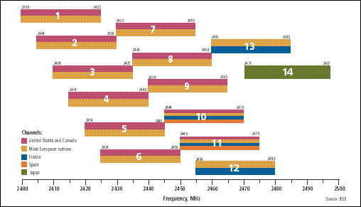
Spread Spectrum Techniques Direct Sequence
2 Mbps data rate without complex modulation scheme
3 Access Points can occupy same area

Slide 16
Comparison between DSSS vs. FHSS
Depends on application
Frequency Hopping
Pros: Cheaper to design & develop
Cons: May not scale to higher speeds
Direct Sequence
Pros: Better scaling to higher speeds
Cons: More complex to design
Who’s winning – Direct Sequence

Slide 17
IEEE 802.11
Specification For Over The Air Interface Between Wireless Clients and Base Stations (Access Points)
Specifies MAC and PHY Layer Like 802.3 Ethernet and 802.5 Token Ring
Conceived in 1990. Final Draft Ratified June 26, 1997

Slide 18
IEEE 802.11 Architecture
Wireless Nodes
Clients
Access Points (AP) - interfaces to a wired network
Basic Service Set (BSS)
two or more wireless nodes that have recognized each other and established communications
Extended Service Set (ESS)
a series of overlapping BSSs’ each containing an AP connected via a Distribution System (DS). The DS is typically Ethernet

Slide 19
IEEE 802.11 Architecture
Two Connection Options:
Infrastructure Network
Ad Hoc Network
Infrastructure Network
Contains at least two nodes one of which is an AP
client to access point (to wired network)
all nodes communicate through the access point
Ad Hoc Network
client to client (no access to the wired network)

Slide 20
Wireless LAN LAN Topology
Notes:
The Basic Service Area or microcell can consist of nothing more than two or more wireless PC’s with a wireless network card.
Operating systems such as Windows 95 or Windows NT has made this type of network very easy to setup.
This can be used for a small office (or home office) to allows a laptop to be connected to the main PC, or for several people to simply share files.
This type of network has one drawback- Coverage limitation. Everyone must be able to hear everyone.

Slide 21
Wireless LAN Typical Single Cell Coverage
LAN Backbone
Wireless Clients
Notes:
To extend the Basic Service Area, or to simply add wireless devices and extend range of an existing wired system, an Access Point can be added to the BSA.
The Term Access Point indicates it is the point at which the wireless clients can ACCESS the backbone.
The Access Point attaches to the backbone (usually Ethernet), and communicates with all the wireless devices in the cell area. The AP is the master for the cell, and controls traffic flow to the network.
The remote devices do not communicate directly with each other, they communicate to the AP.

Slide 22
Wireless LAN Typical Multicell Topology
Wireless
“Cell”
Channel 1
D
Channel 6
LAN Backbone
Access Point
A
B
C
Wireless Clients
Notes:
If a single cell does not provide enough coverage, then any number of cells can be added to extend the range. This is known as an Extended Service Area.
The cells usually have 10-15% of overlap to allow the remotes to roam without losing RF connections, and provides maximum coverage with minimum cost. For the Direct Sequence all APs are manually set to the a frequency. For the Frequency Hopping system, the hopping pattern is, by default, automatically selected.
You can select channels that are on non-overlapping, non-interfering frequencies on DS, or on FH, different hopping patterns, and the overlap is not critical, as long as it has full coverage areas. The clients will chose the best AP based upon the association processed discussed earlier.

Slide 23
IEEE 802.11- Standards Status
Although Standards Based, No Guarantees Of Vendor Interoperability… Therefore lots of field testing is necessary
No AP to AP Coordination For Roaming
No 802.11 Conformance Test Suite…see University of New Hampshire web site
Notes:
The University of New Hampshire has been most active with interoperability testing. Tests show that client to Access Point interoperability exists to a large degree. AP to AP

Slide 24
IEEE 802.11 Evolution
Spec. Description Est. Data Rate Act. Data Rate Frequency
802.11 Most widely deployed 2 Mbps 1.6 Mbps 2.4GHz
802.11b ratified 9/99 11 Mbps 5.5 Mbps 2.4GHz
802.11a In development 54 Mbps 25 Mbps 5GHz
HiperLAN Developed by European 24 Mbps 11 Mbps 5GHz

Slide 25
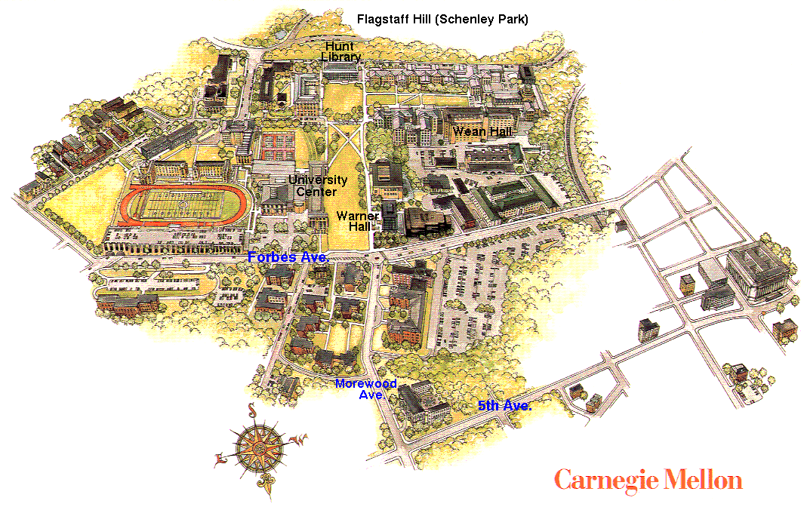
Carnegie Mellon Background
50+ buildings on 100+ acre campus
Half of buildings are on contiguous main campus
No Standard Existed for Wireless LANs
Evaluation + Selection: ATT/Lucent 915Mhz
Deployed network in 6 campus buildings
Enable use by approximately 150 users
Research Network = Limited Support
Early adopters in use of distributed computing and networks (Andrew Project)

Slide 26
Wireless Andrew Subnet
Andrew wireless envisions
Wireless supports existing uses
Separate network

Slide 27
Selection of Partner
Concern for Selecting Partner:
Scalability of products and systems
Ability to design an effective network
Ability to manage the wireless network and provide operational service levels acceptable to wireline Andrew users.
Competitive Vendors
Xircom, Proem and Lucent
Key Parameter:
Coverage, Throughput, Form factor, Ease of use and Apple MAC support and PC support.
Coverage cost per unit
1.0 -> 915 MHz, 1.67 -> 2.4 GHz, 3.76 -> Xircom’s product
In 1995, They decided to work with 915 MHz WaveLAN product from Lucent Technology.
In 1999, they have competed the coverage of whole campus with latest 2.4 GHz technology from Lucent

Slide 28
Initial Lab tests for selection of partner

Slide 29
Lucent WaveLAN Product
Phase I was composed of two main elements:
The Lucent WaveLAN access points / WavePoint units.
Radio base station, mounted in a fixed position, connected to wired local network.
Contains a transmitter,receiver,antenna, and a bridge.
Network adapters/WaveLAN units.
Using direct sequence spread spectrum and CSMA/CA medium access control.
Contains a transmitter,receiver,antenna and the hardware provides the data interface to the mobile computer.
Available in PCMCIA and is installed in a mobile.
This equipment uses a direct sequence spread spectrum to provide a raw data rate of 2Mbps.

Slide 30
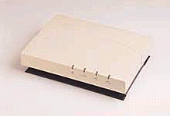
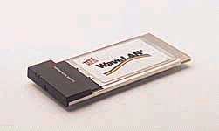
Key Components- Wireless LAN
Access Point - network device that links wireless stations to the wired network -- $200/unit
Wireless NIC cards- EISA bus or PC card -radio transceivers for the end users -- $795/card
$595/card
$275/card
$150/card
$95/card

Slide 31
Design factors to consider
Interference
Throughput
Coverage Vs. Capacity.
Wireless design is as much Art as Science.
The wireless industry is evolving their products to support campus environments (but they are still behind the wired side of networking).

Slide 32
Interference Sources
ISM band is shared band between 902-928 MHz. Different users and applications operates in this band.
Applications operates in ISM 902-928 MHz band (Potential sources of interference):
Wireless stereo speakers
Industrial heaters
Food preparation equipment
Military radar
Video Surveillance cameras
Commercial location and monitor services
Cordless phones operated in 915 MHz and 2.4 GHz
Interference: Different users and application operates in the same frequency, they interference to each other.
The problem with so many devices using the same band is that the interference is likely and given 802.11 specs, it will reduce the throughput

Slide 33
Solutions for Interference.
To overcome effects of foreign interference one can add more access point effectively increasing the signal to client devices. However this will increase the interference between access points themselves.
These problems were resolved by configuring the access point appropriately that changed the coverage area and creation of additional channel.
The process however is experimental.
One has to map out the deployment area in terms of presence of signals in ISM band using spectrum analyzer
Additional configuration effort is required either to overcome foreign interference or overlapping coverage problems.

Slide 34
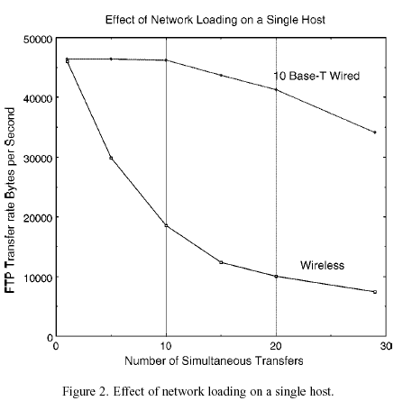
Throughput
Their main concern was the performance in a situation where a large number of users, request simultaneous services.
They found from experiment that data throughput of 2 Mbit/s was reduced as they increased the device but it was reasonably shared among wireless devices.

Slide 35
Throughput Contd..
In class room environment, it was possible that one access point may not be sufficient to provide for sufficient throughput. Additional access points were necessary.
This however led to interference problem between APs
Lucent however provided ways to configure the APs and additional channels in APs that could help with the interference problem.
This has been an acceptable solution but requiring lots of testing, experimenting on the site.
This will remain a matter of cost and concern until more automated way of changing the coverage and channel selection is arrived at.

Slide 36
Design Issues (Coverage)
To design network with good performance and economics is the main factor.
Ensure that reasonable coverage is provided through out the service area.
Two issues:
Holes in coverage
Examine the building drawings, estimate coverage, place the access points, signal-noise ratio, then fill coverage holes with additional access points.
Marginal Coverage Areas
Cost perspective, place the access points as far as apart for coverage.
It causes coverage gap problem, where there is no service available.
Solution to place the additional access points
Coverage area of a access point is relatively small, terrain is not a propagation issue.
The layout and construction of buildings determine the coverage area of each access points.
IEEE 802.11 protocol is contention-oriented, it provides a mechanism which allows all units to share the bandwidth resource.
This contention-oriented protocol makes interference between access points, which is a problem.
Rules of thumb are inadequate.

Slide 37
Design Issues (Capacity)
Design should consider the issue of capacity.
To use multiple access point to serve a high density group, located in a small area.
Design should be both coverage-oriented and capacity-oriented.
Two design layout techniques which are useful in high-density capacity situations:
Adjusting the receiver threshold setting
The WaveLAN product allows to set threshold settings, controlling the size of the coverage area of the access point.
Using the frequency reuse
In 2.4 GHz band, access points can operate on separate non-interfering channels.
Wireless Andrew uses coverage oriented techniques - capacity areas, Combination of coverage & capacity oriented techniques - high-capacity areas.

Slide 38
Troubleshooting Issues
Lack of tools suitable for management of a large dispersed wireless network.
Dispersed nature of devices compared to wireline units.
Difficulty in diagnosing problems in the link between the access point and the end user.
The mobile nature of possible problem source

Slide 39
Where are we now?
We cover 30+ buildings (to date)- 350 APs
We cover over 3 M sq. ft. of office/lab/classroom space
We cover roughly 99% of the academic campus.
We have 2000+ users
We are planning a summer expansion of wireless coverage to the dormitories – 30 Bldg., 800KSq Ft of interior space, approx 3000 “beds”.

Slide 40
Wireless Campus by 9/01
Residence Halls,
Academic and Administrative Buildings
Residence Halls, Parking, etc

Slide 41
How Much?? $$$, coverage
Average cost of wireless: <$1K for AP, <$1K for power/data install, + wired network infrastructure costs+design labor costs.
Avg. pwr/data install schedule– 8 locations / wk
Avg. AP installs - 8 per day
AP to sq.ft. density: depends on building construction and arch concerns, ex: older construction 25 A.P.s cover 228Ksq.ft., newer construction 12 A.P.s cover 210Ksq.ft.
Best coverage 17.5Ksqft/AP, Worst 3.4Ksqft/AP
Your mileage WILL VARY!!!

Slide 42
Wireless Andrew Configurations
Workstations/OS
Windows 95, 98, NT, 2000
Macintoshes
Linux
Windows CE
Applications
data files
Internet/Intranet
email
Web
centralized calendar

Slide 43
Wireless Andrew Issues/Futures
Coverage Vs capacity – Why not both?
“Airspace policy” and interference –Bluetooth,…
Keeping up with demand- scaling issues
Security-Authentication- 802.1x ??
Next Gen 802.11(a) –5Ghz Issues:
Fork-lift upgrade? Ease of transition?

Slide 44
Q & A

